Slide 1

It’s a long way to the shop.

Slide 2




How will she travel?
?

Slide 3
How will she travel?
?

Slide 4
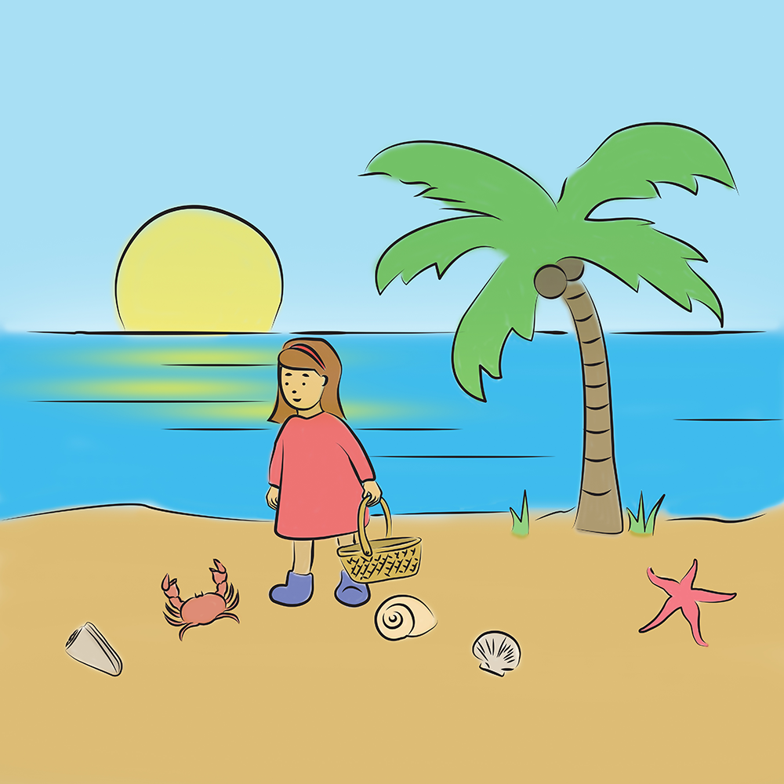
How will she travel?
?

Slide 5




How will she travel?
?

Slide 6
How will she travel?
?

Slide 7

How will she travel?
?

Slide 8




How will she travel?
?

Slide 9
How will she travel?
?

Slide 10
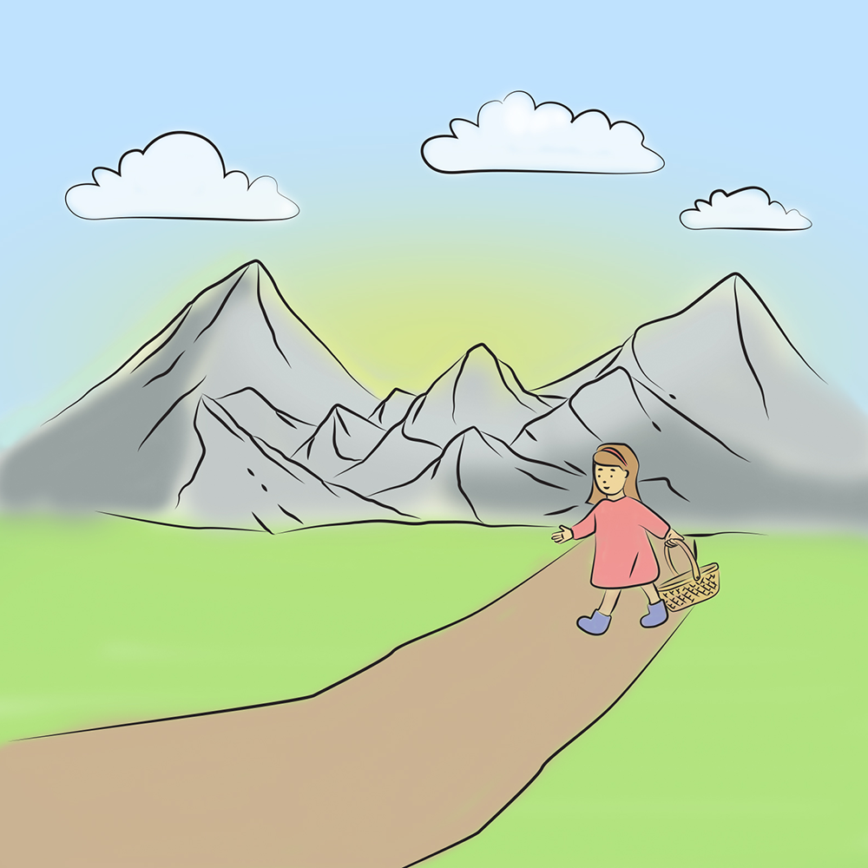
How will she travel?
?

Slide 11



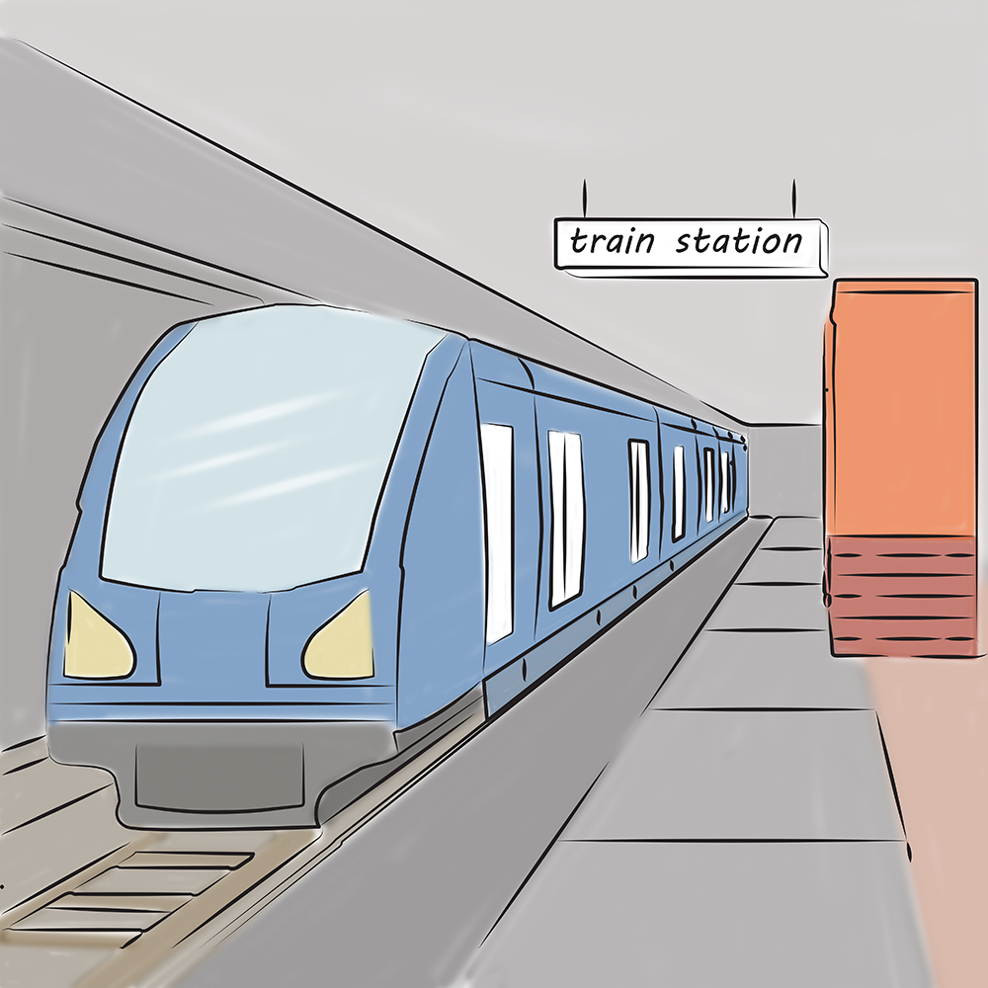
How will she travel?
?

Slide 12
How will she travel?
?

Slide 13
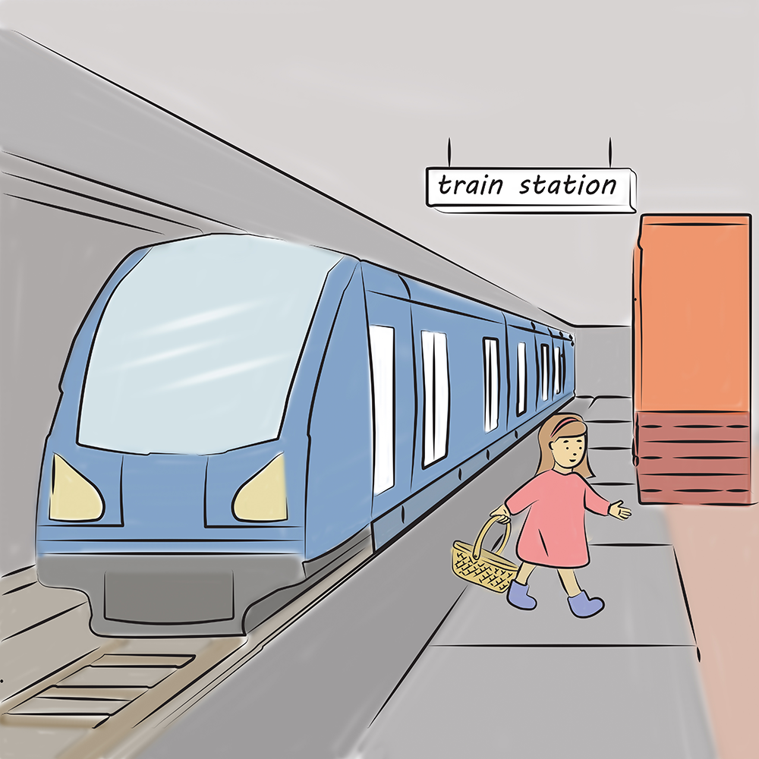
How will she travel?
?

Slide 14




How will she travel?
?

Slide 15
How will she travel?
?

Slide 16
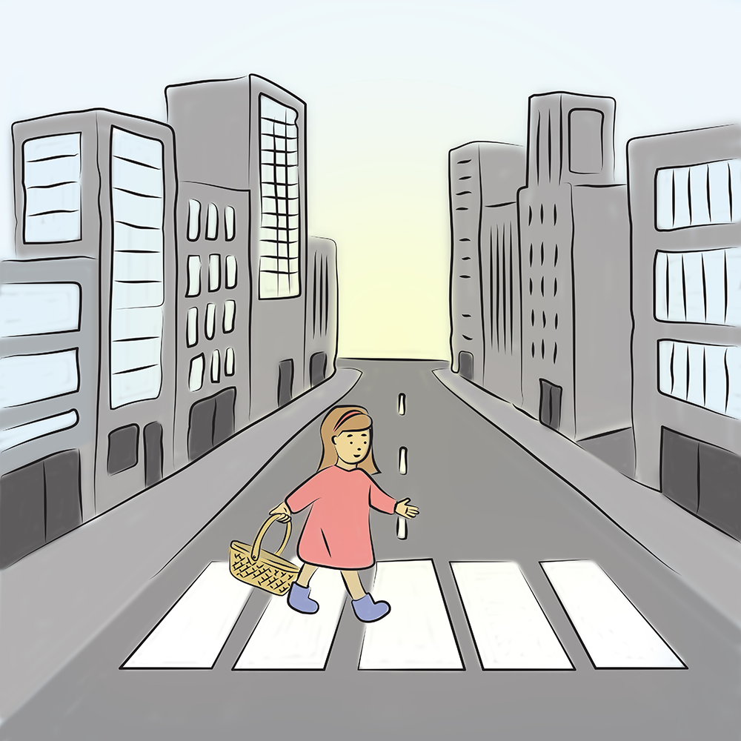
How will she travel?
?

Slide 17



How will she travel?
?

Slide 18
How will she travel?
?

Slide 19
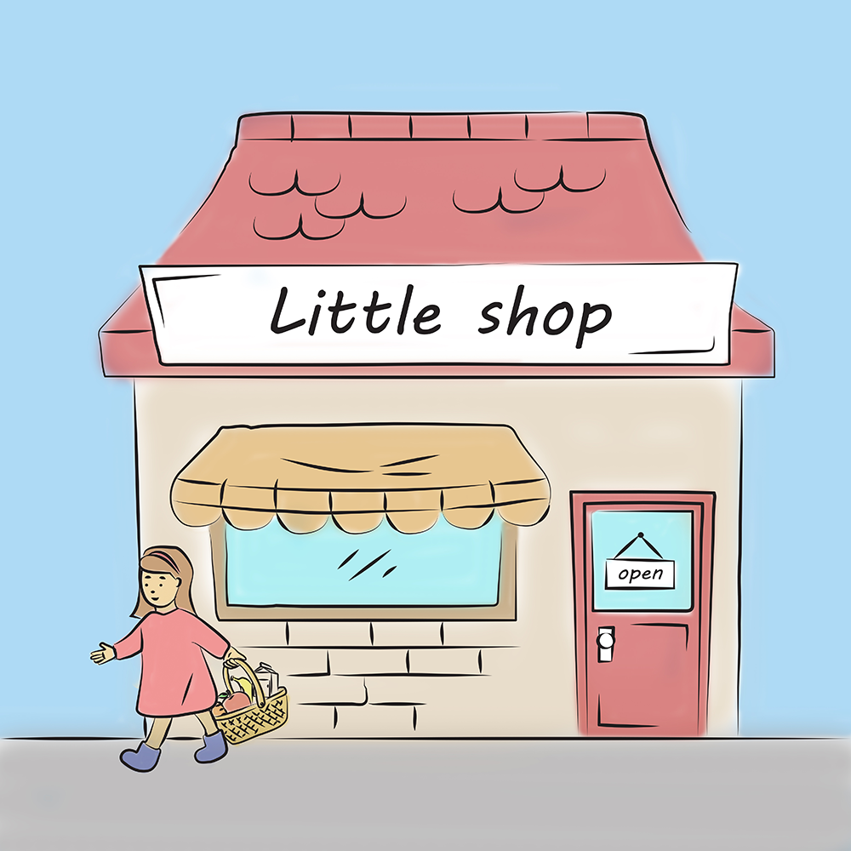
How will she travel?
?

Slide 20


How will she travel?
?

Slide 21
How will she travel?
?

Slide 22
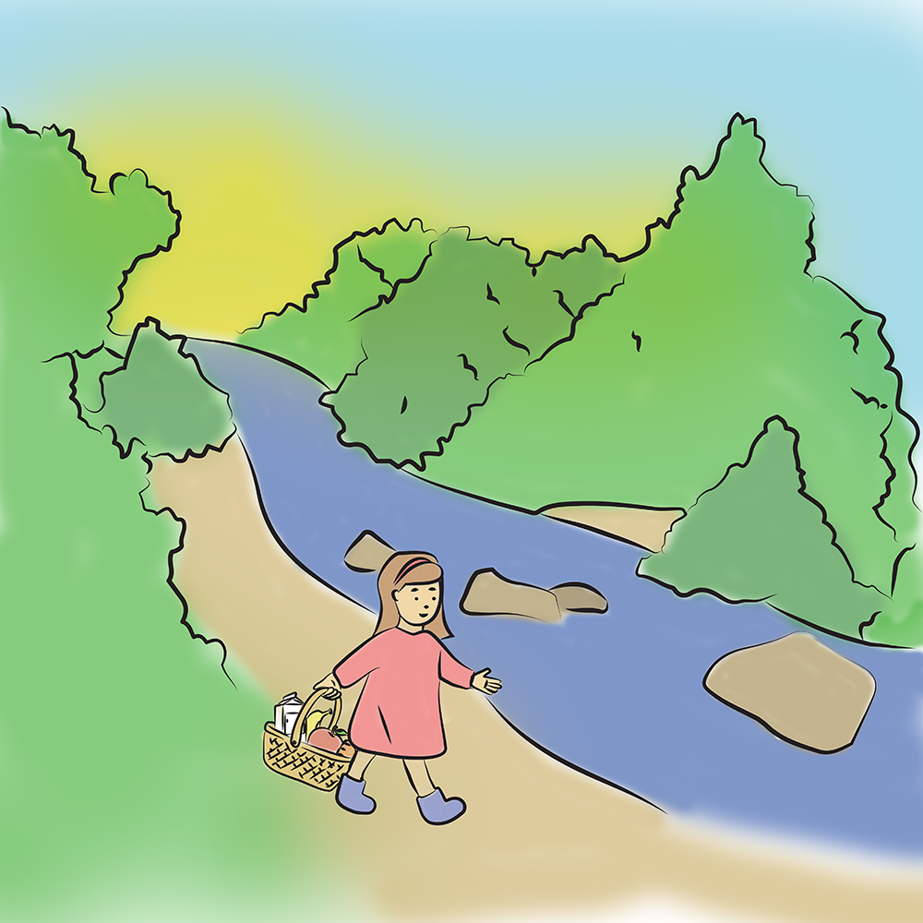
How will she travel?
?

Slide 23
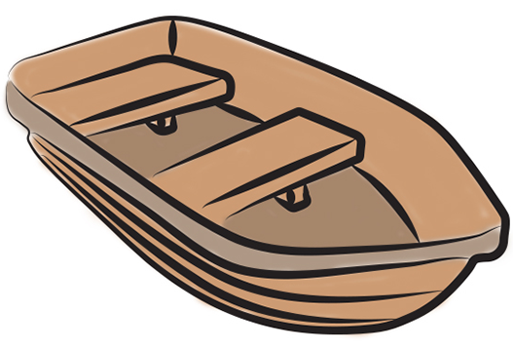

How will she travel?
?

Slide 24
How will she travel?
?

Slide 25

How will she travel?
?

Slide 26
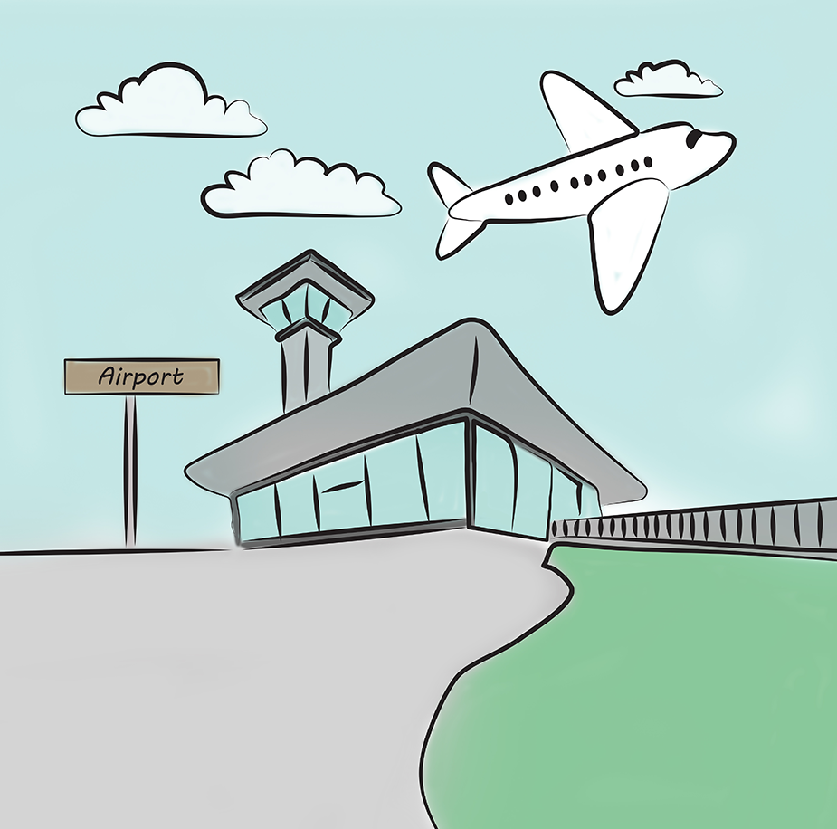
How will she travel?
?

Slide 27
How will she travel?
?

Slide 28
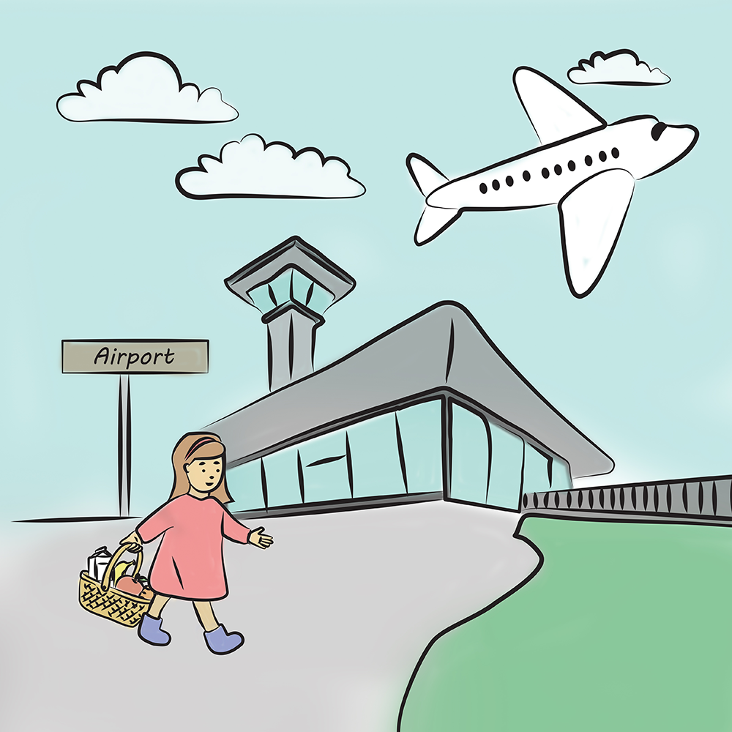
How will she travel?
?

Slide 29

How will she travel?
?

Slide 30
How will she travel?
?

Slide 31
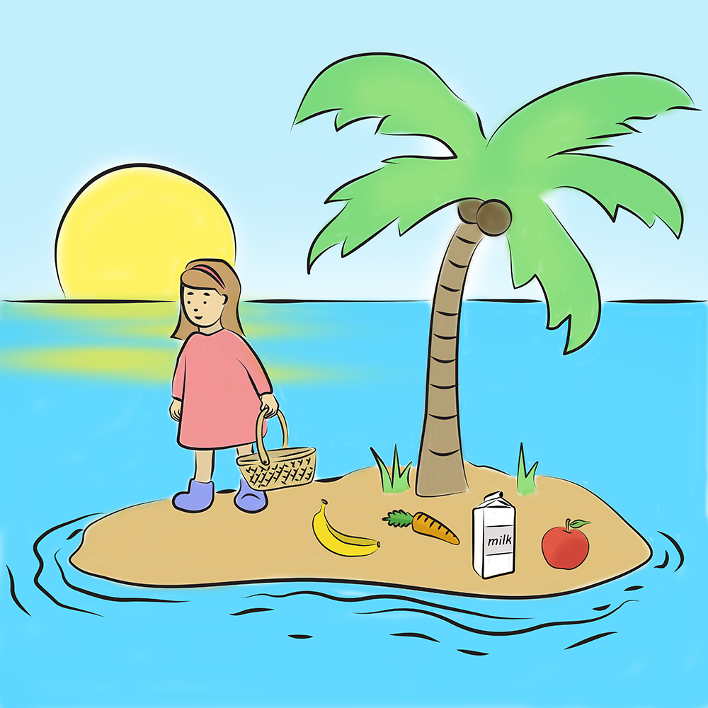
How will she travel?
?

Slide 32
Any questions?
Contact us!
rehabilitation@medel.com

