Slide 1
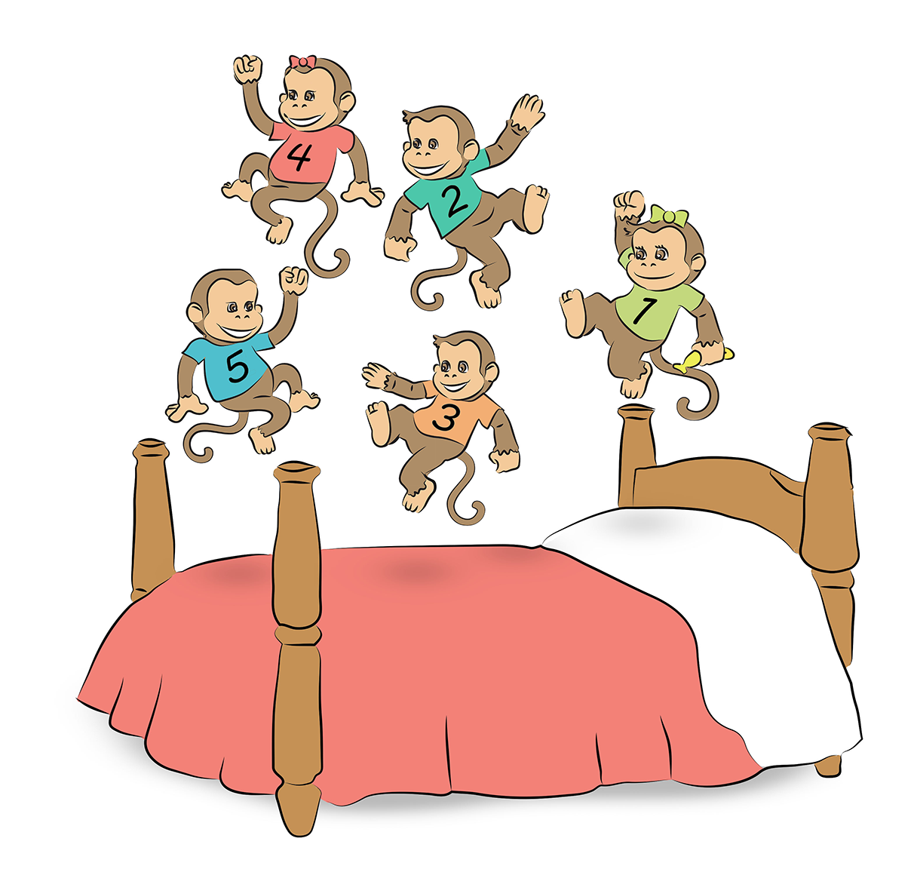
5 little monkeys are jumping on the bed.

Slide 2
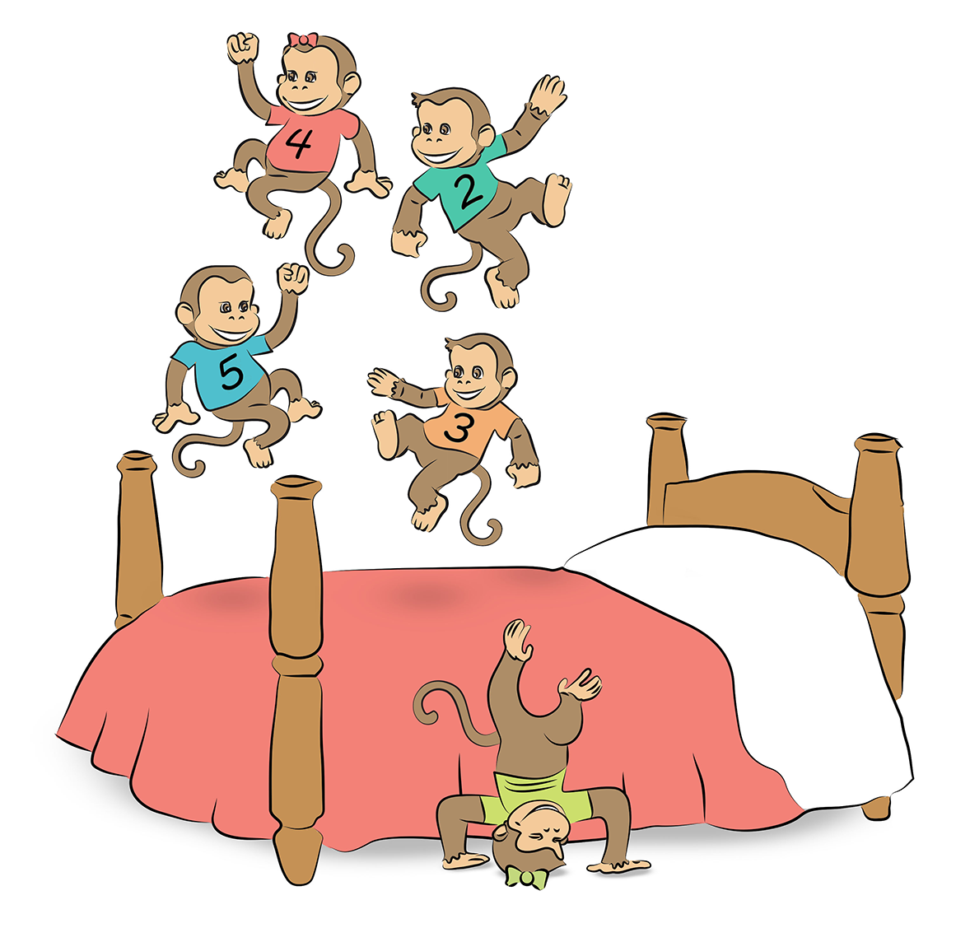
1 fell off….

Slide 3
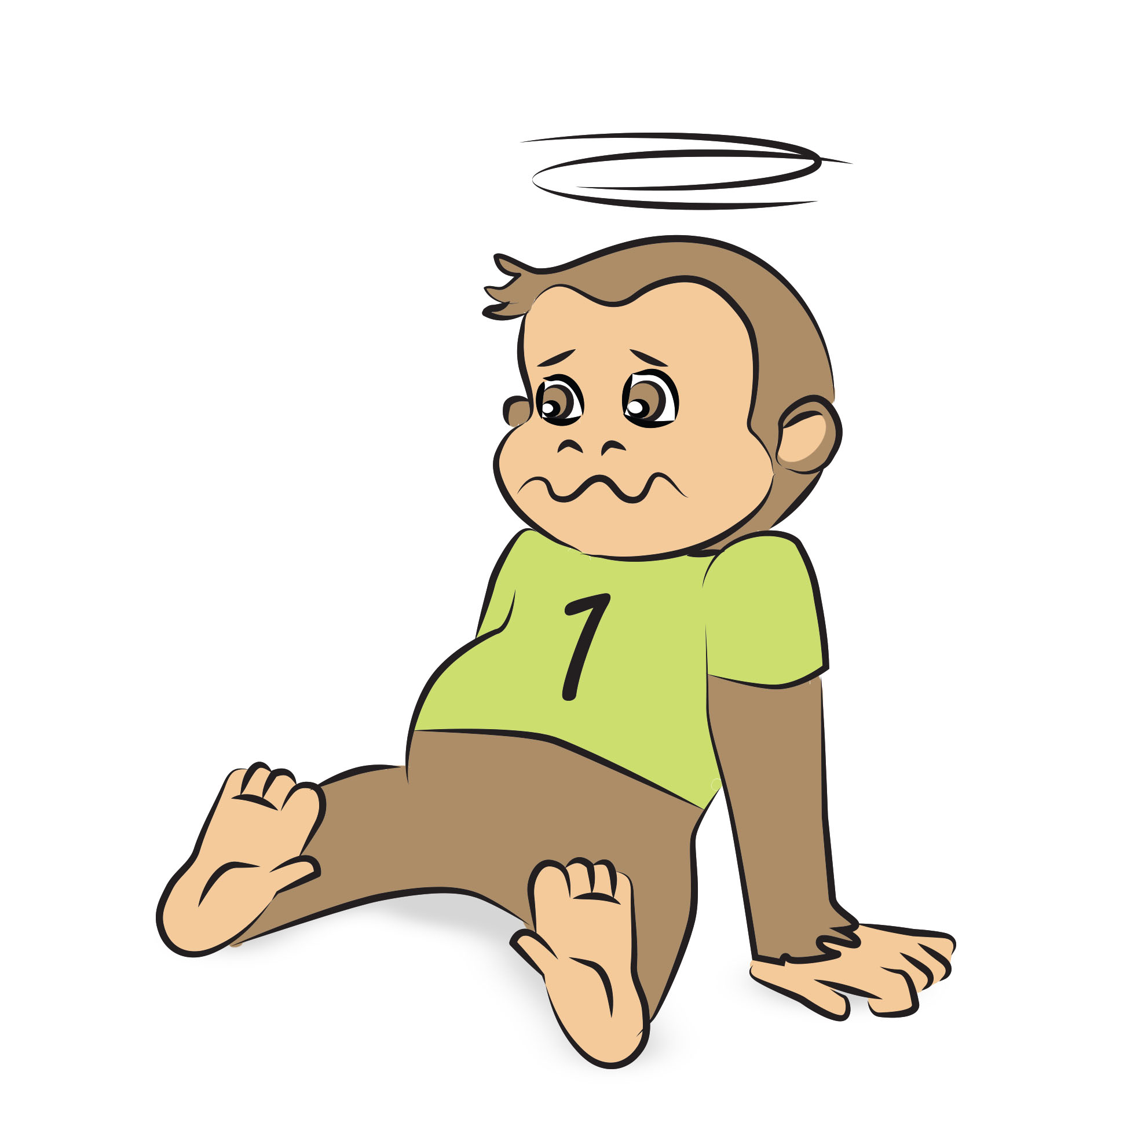
and bumped her head.

Slide 4
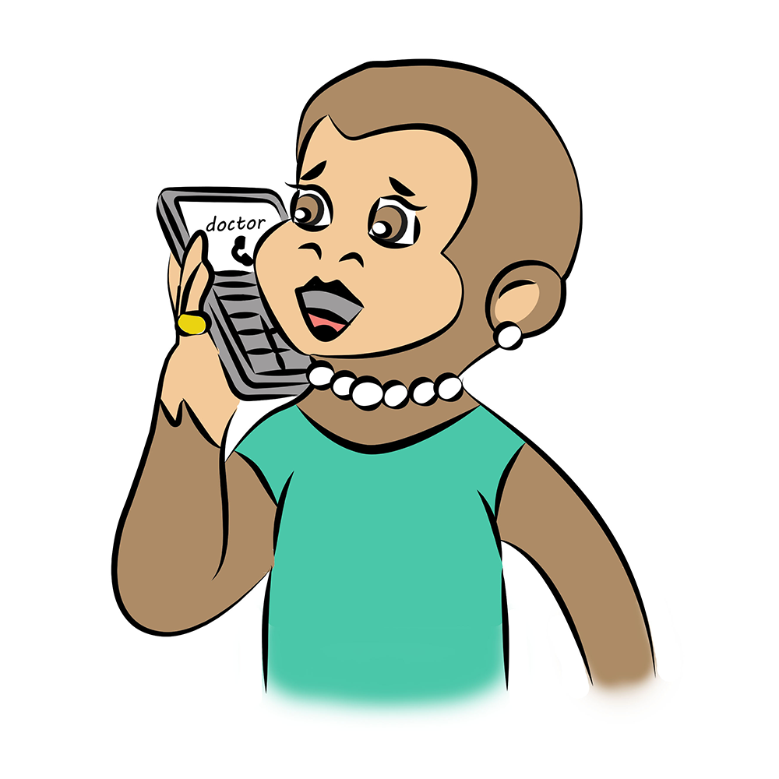
Mama called up the doctor.

Slide 5
and the doctor said,
No more monkeys jumping on the bed!

Slide 6
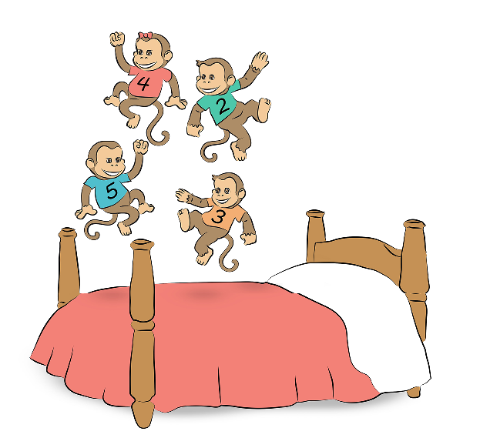
4 little monkeys are jumping on the bed.

Slide 7
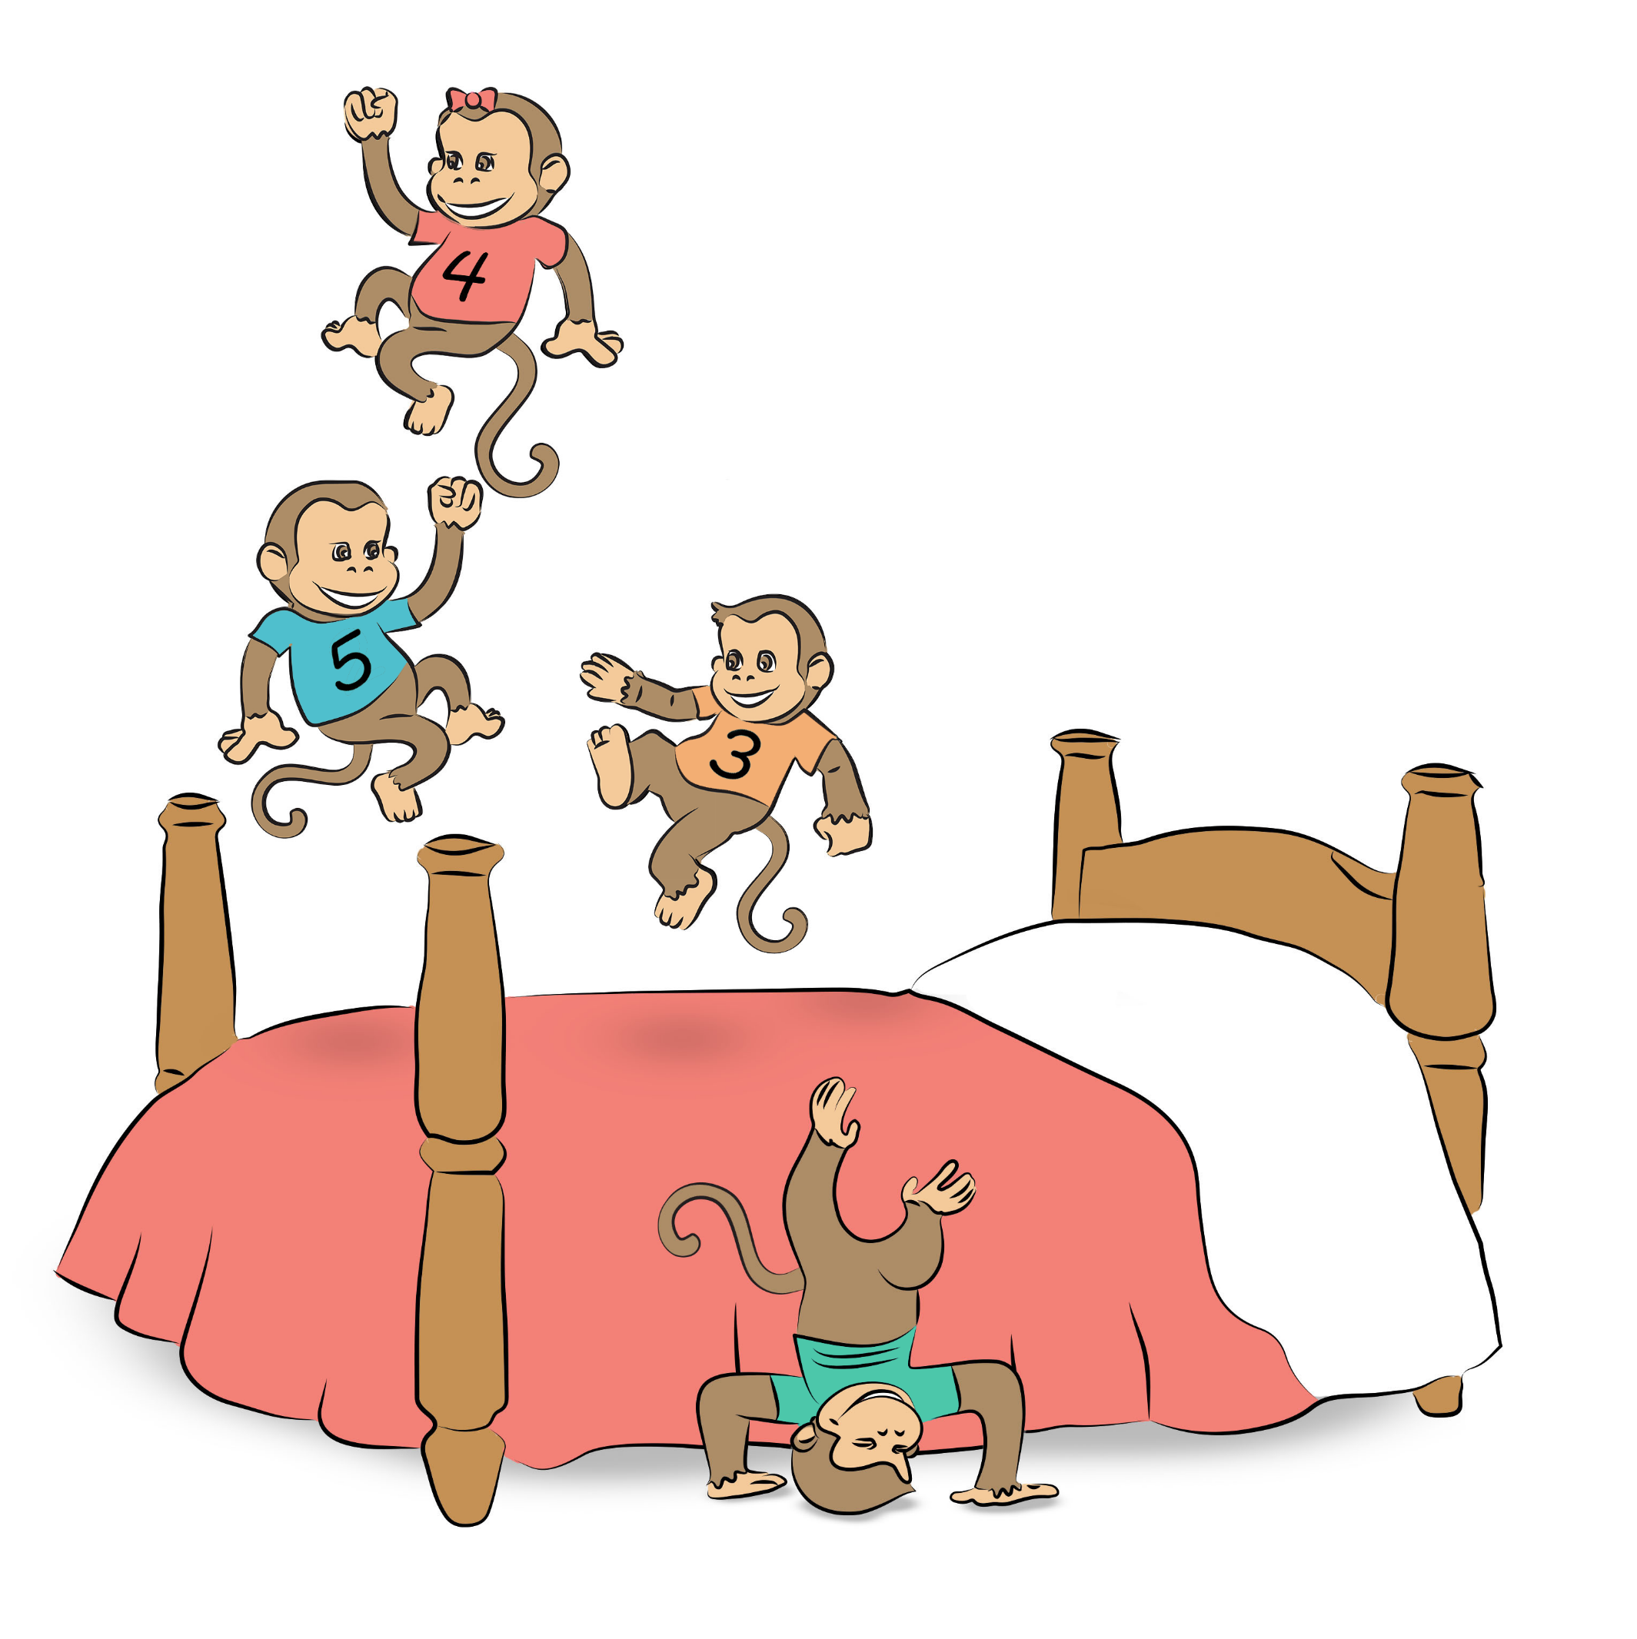
1 fell off….

Slide 8
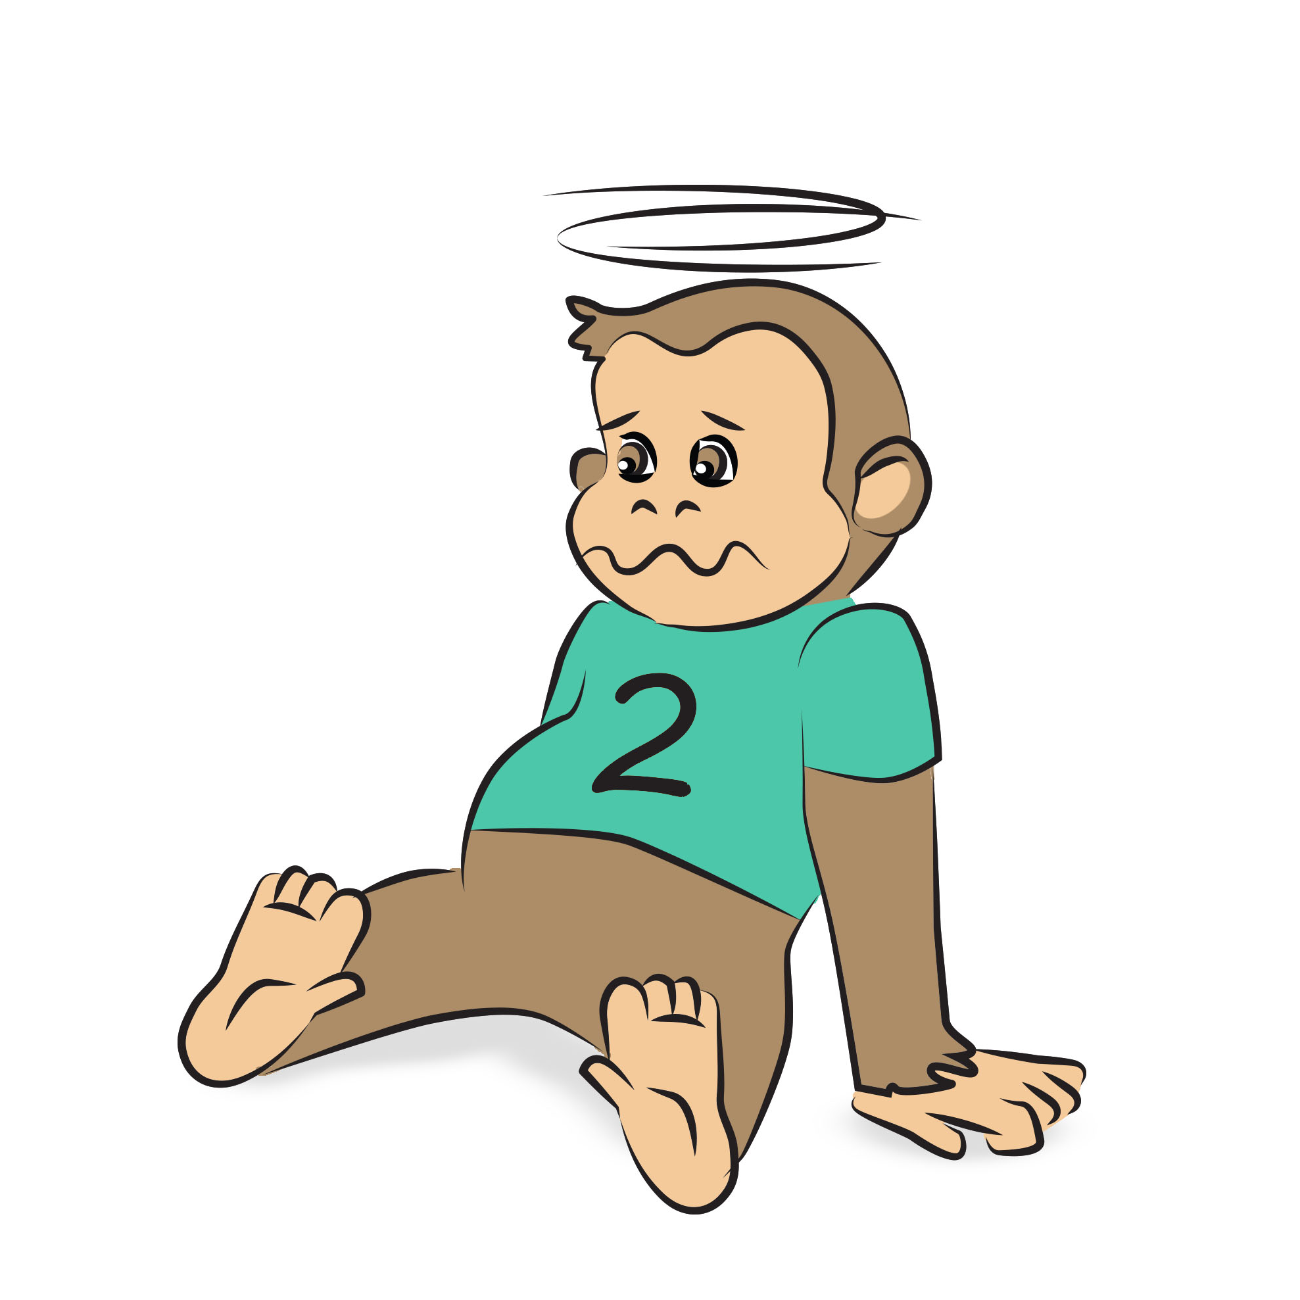
and bumped his head.

Slide 9
Mama called up the doctor.

Slide 10
and the doctor said,
No more monkeys jumping on the bed!

Slide 11
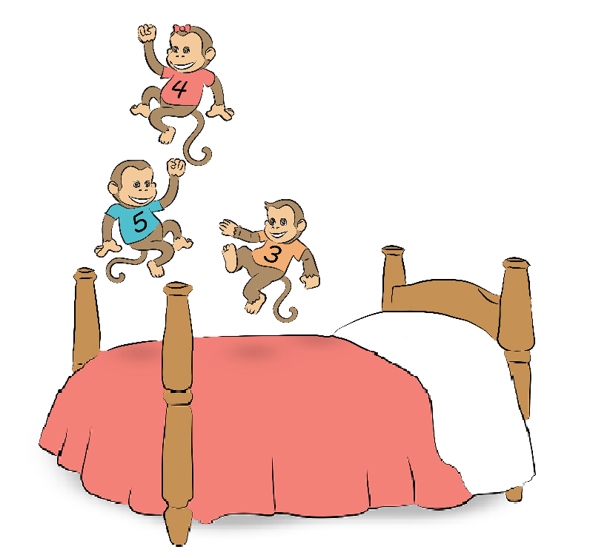
3 little monkeys are jumping on the bed.

Slide 12
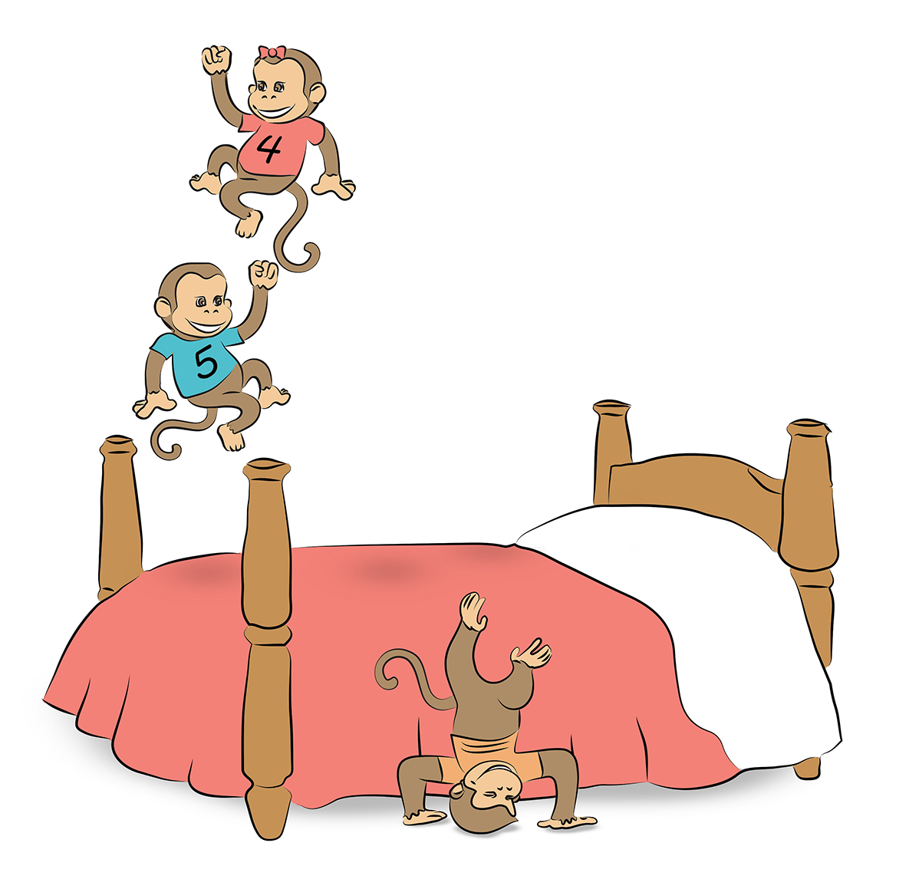
1 fell off….

Slide 13
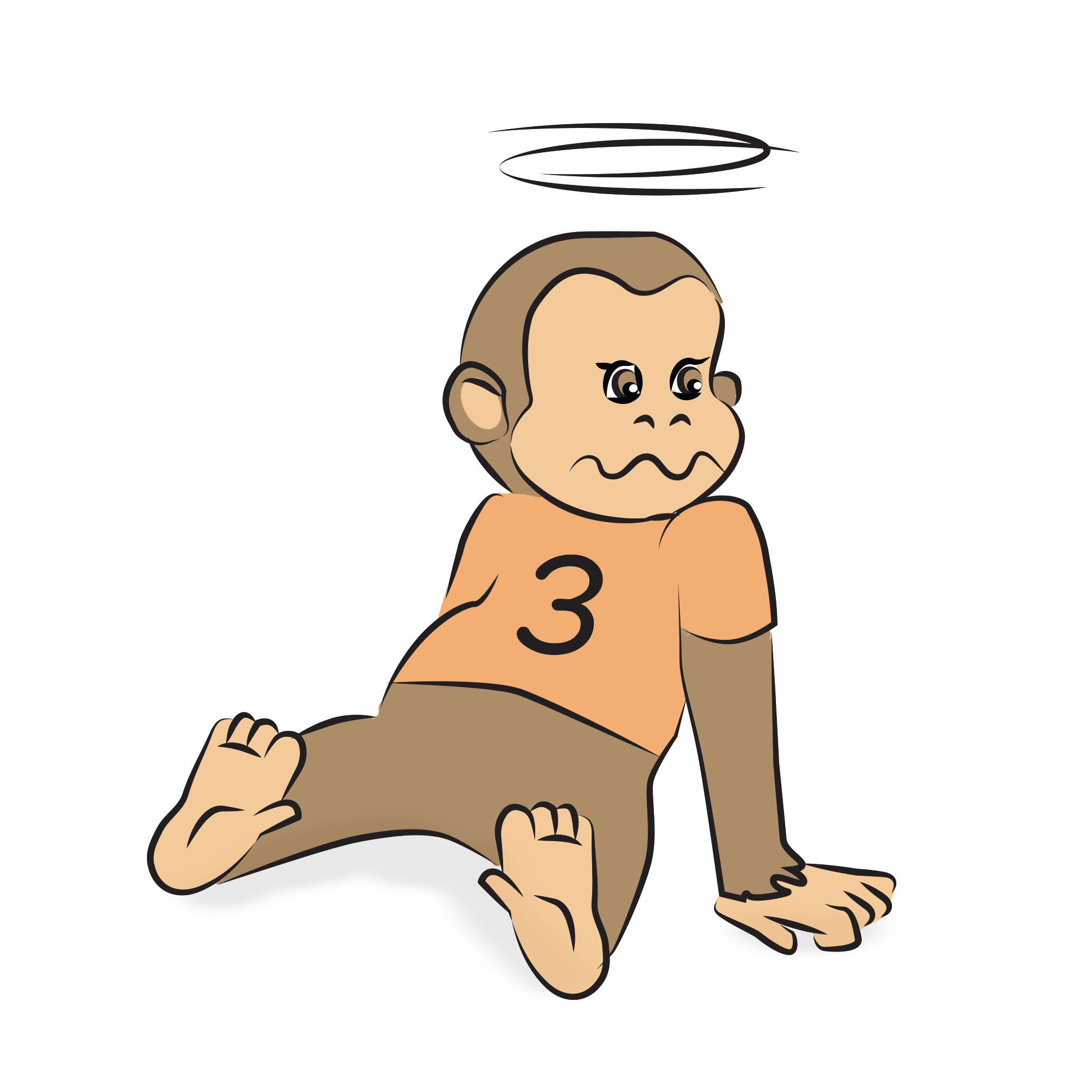
and bumped his head.

Slide 14
Mama called up the doctor.

Slide 15
and the doctor said,
No more monkeys jumping on the bed!

Slide 16
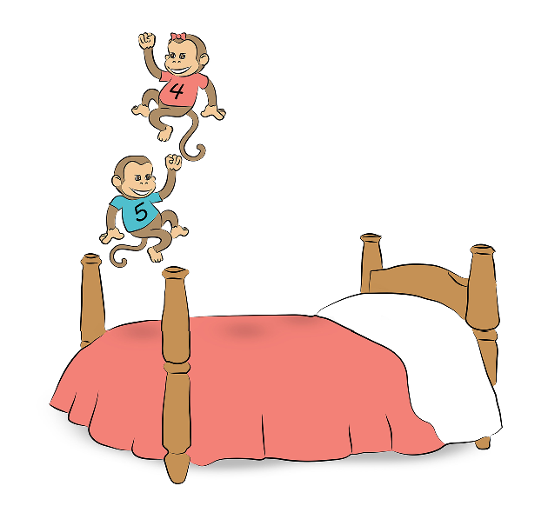
2 little monkeys are jumping on the bed.

Slide 17
1 fell off….

Slide 18
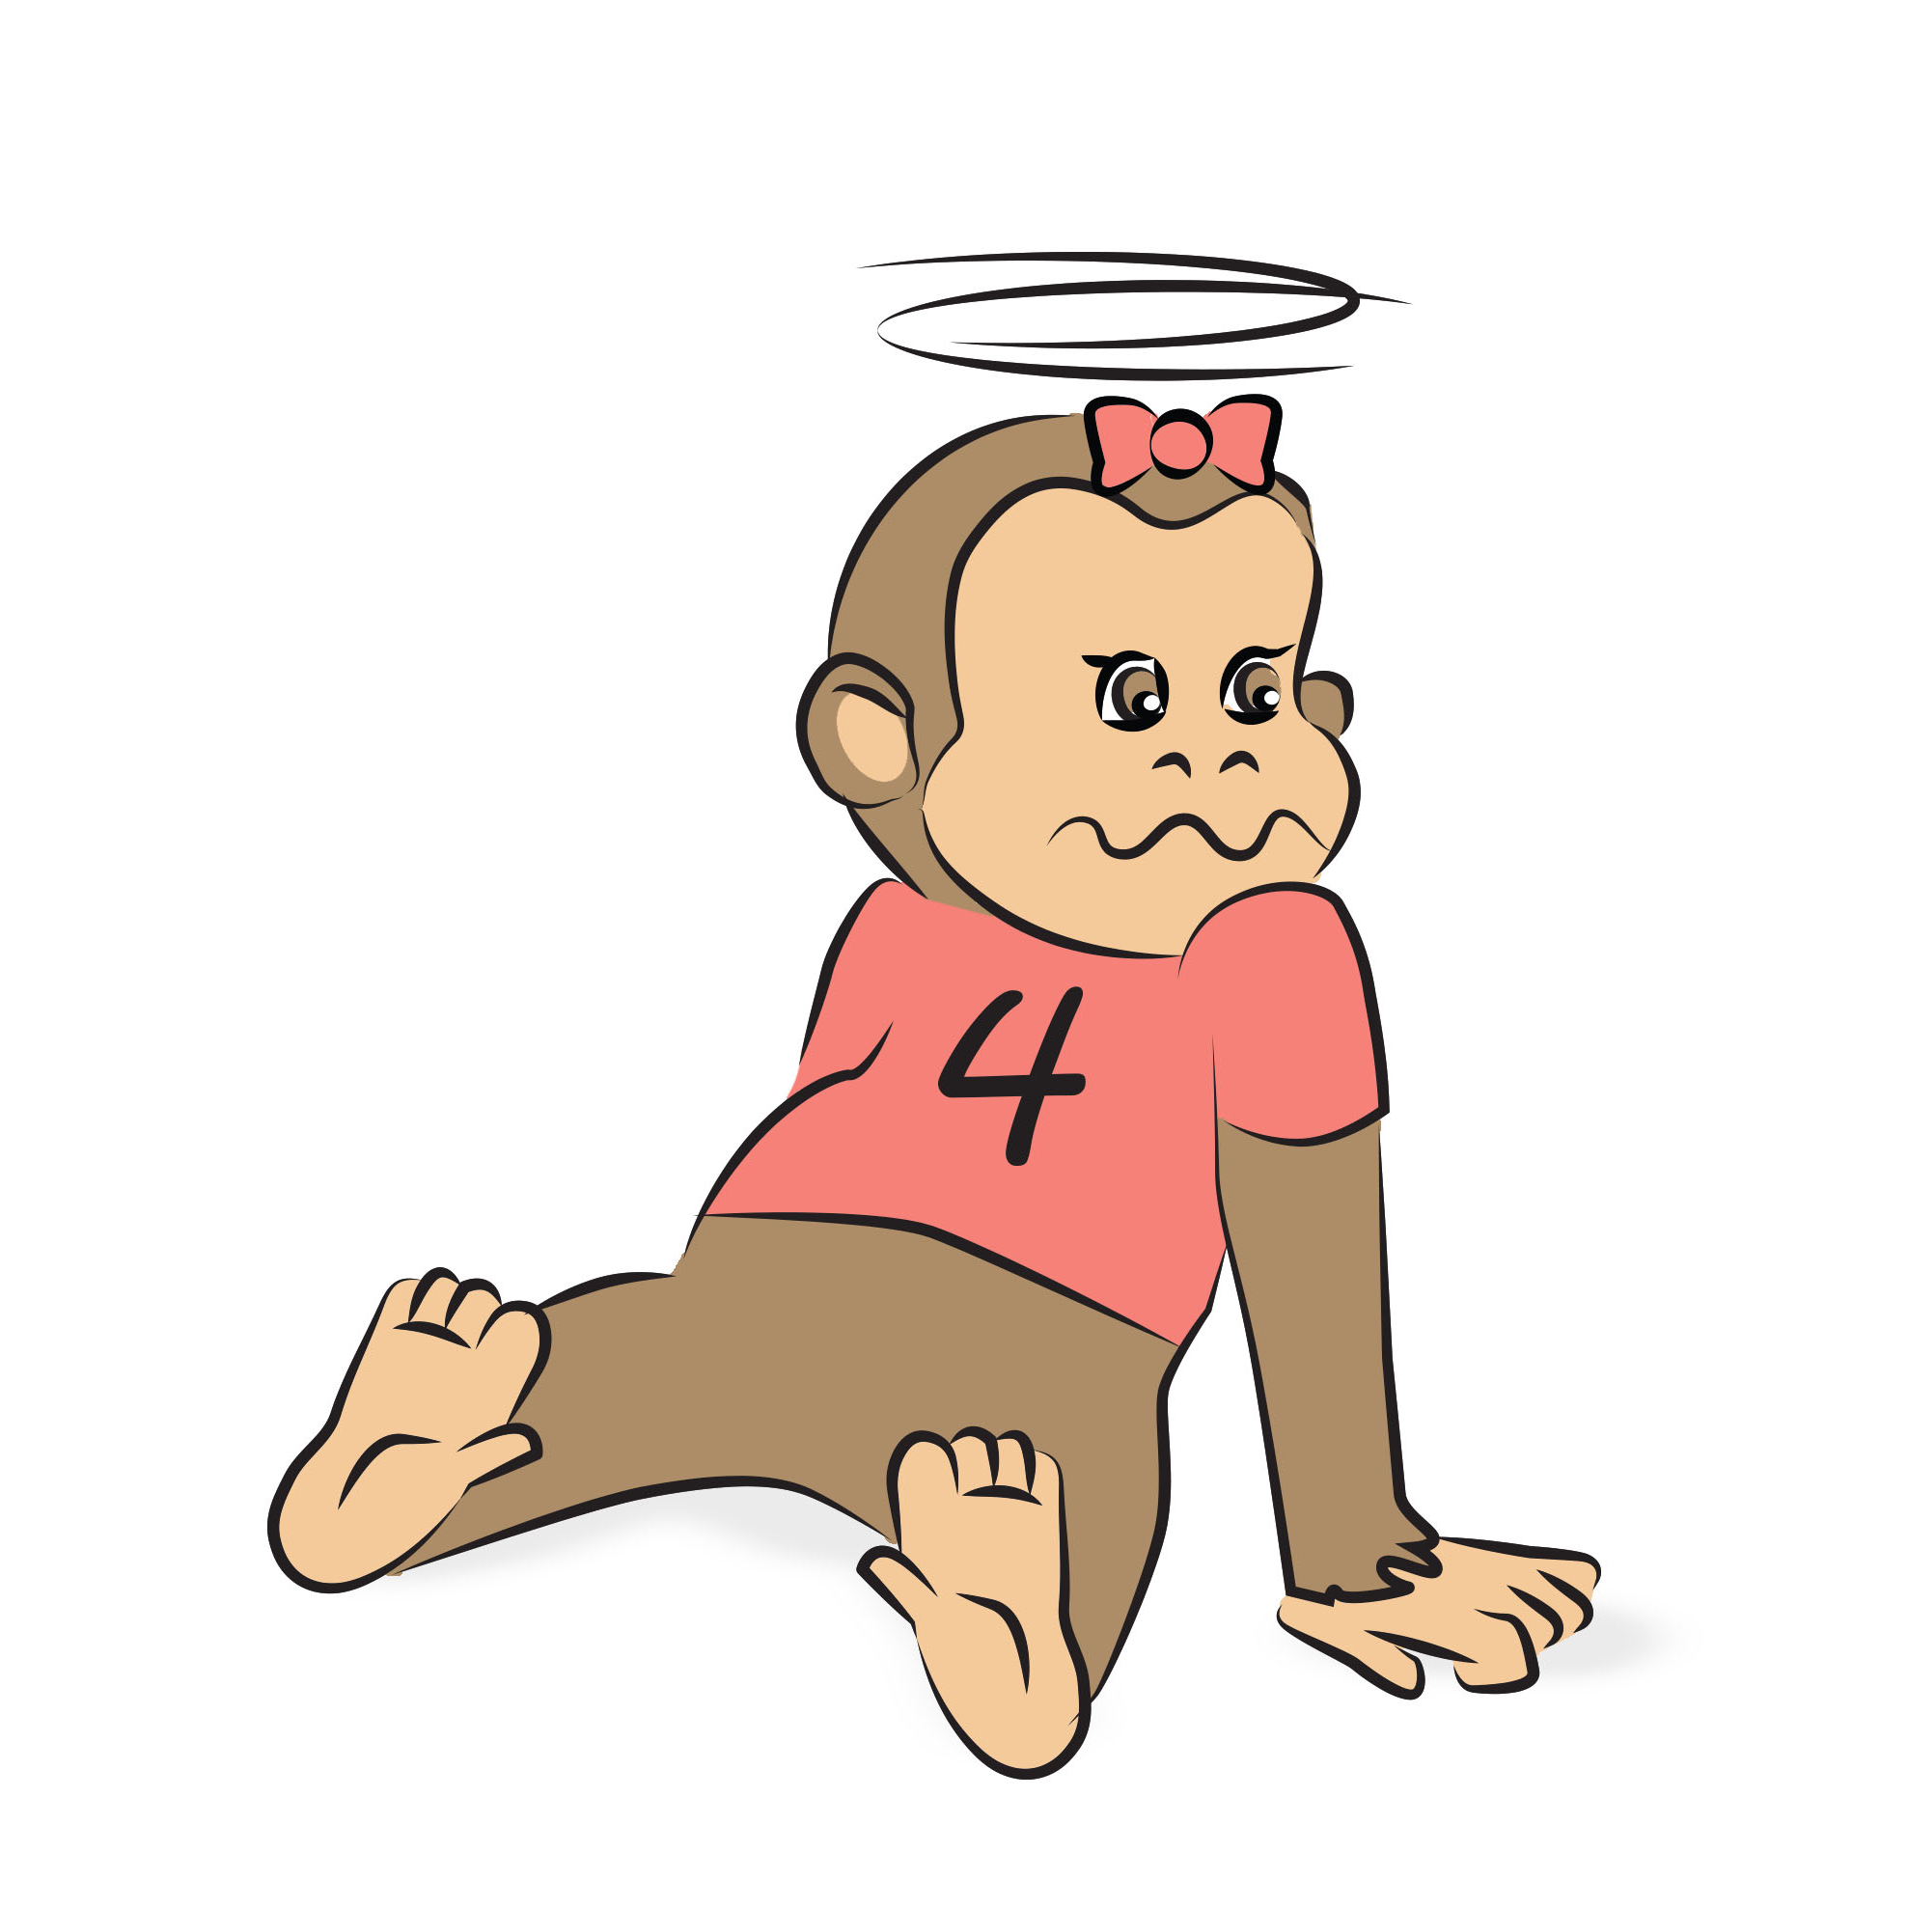
and bumped her head.

Slide 19
Mama called up the doctor.

Slide 20
and the doctor said,
No more monkeys jumping on the bed!

Slide 21
1 little monkey is jumping on the bed.

Slide 22
He fell off….

Slide 23
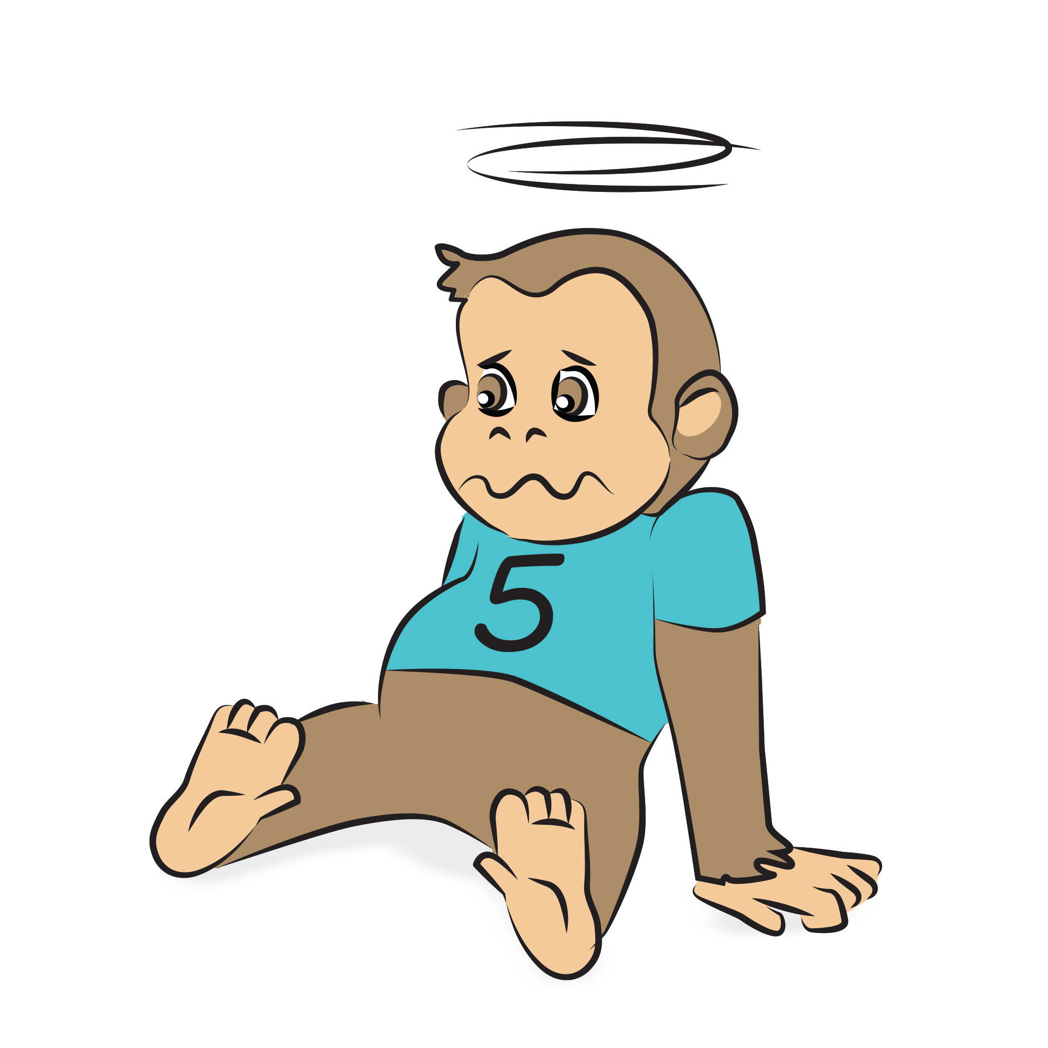
and bumped his head.

Slide 24
Mama called up the doctor.

Slide 25
and the doctor said,
No more monkeys jumping on the bed!

Slide 27
Any questions?
Contact us!
rehabilitation@medel.com

