Slide 1
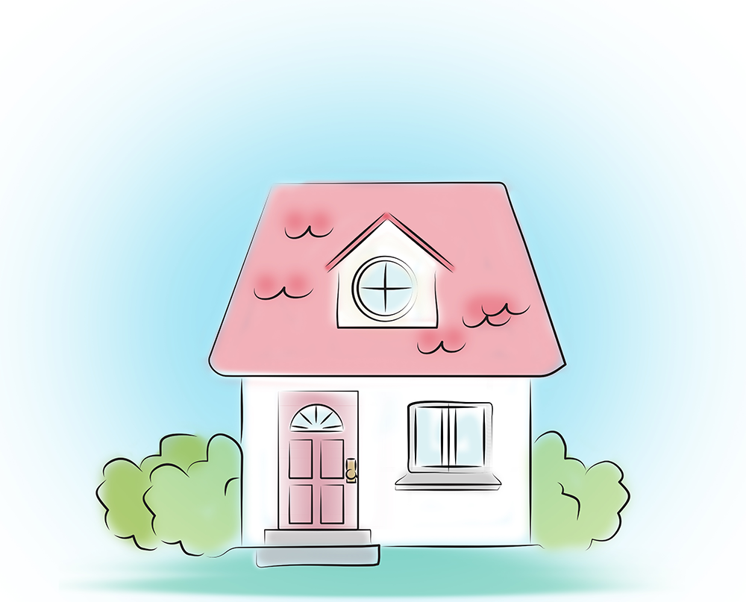
My house
© Copyright MED-EL 2020

Slide 2
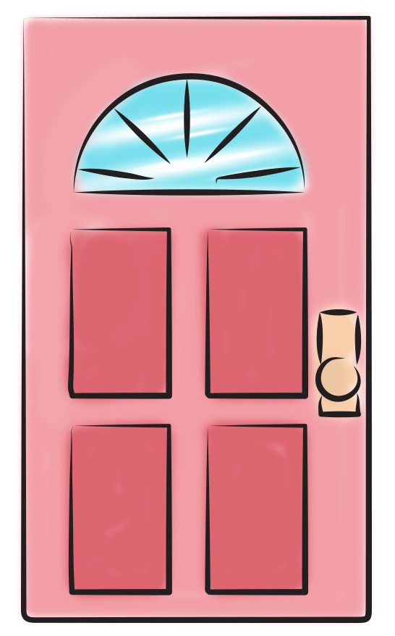
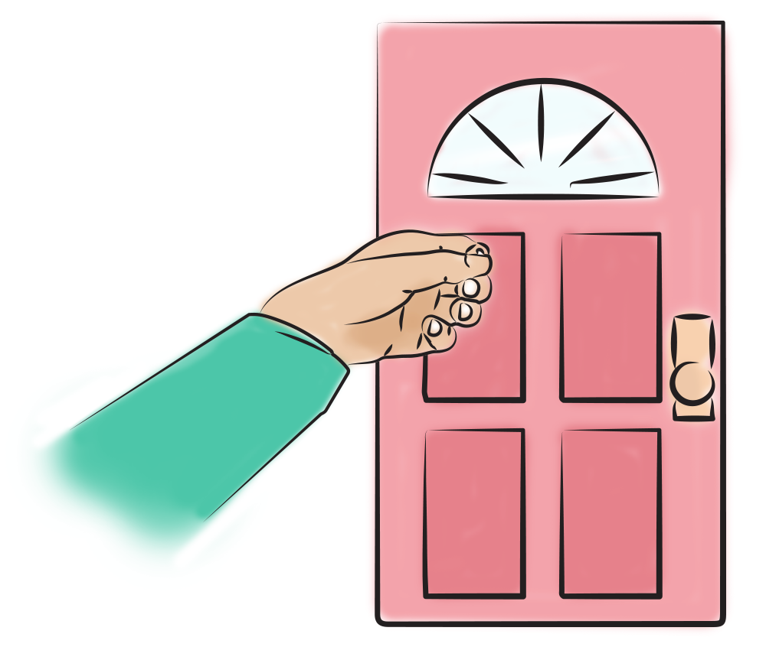
My house has
for knocking on.
a big front door
© Copyright MED-EL 2020

Slide 3
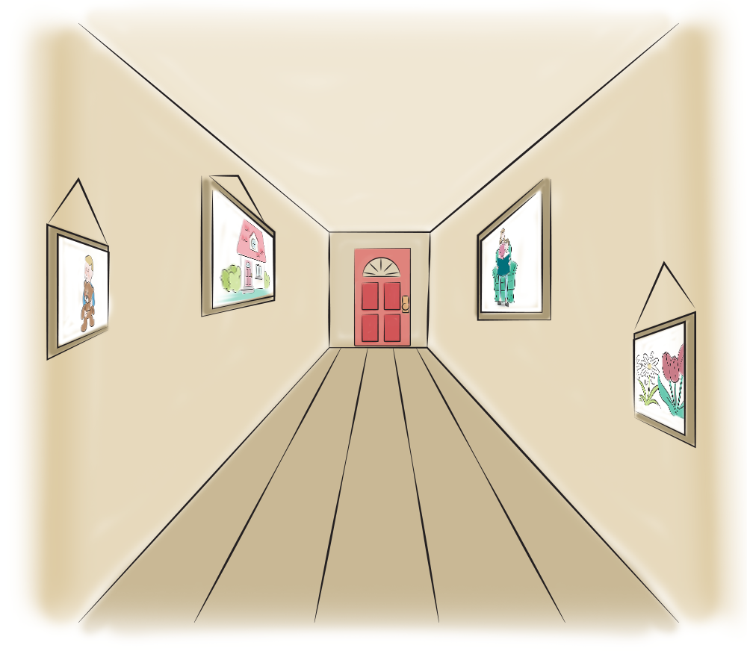
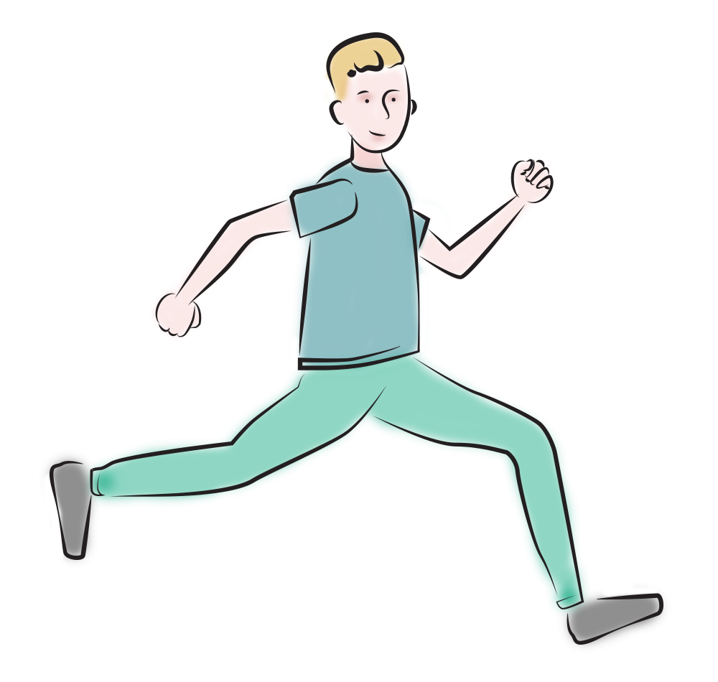
My house has
a long narrow hall
for running through.
© Copyright MED-EL 2020

Slide 4

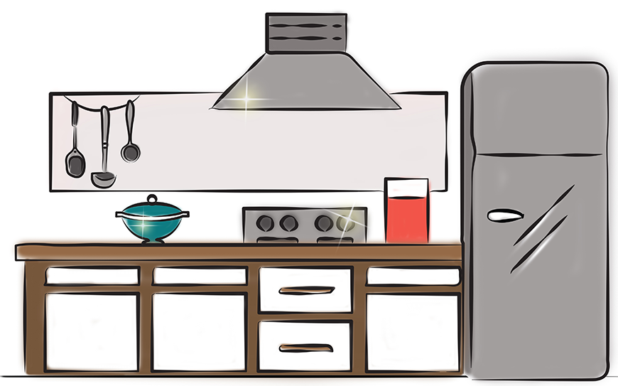
My house has
a kitchen filled
with shiny things
for cooking with.
© Copyright MED-EL 2020

Slide 5

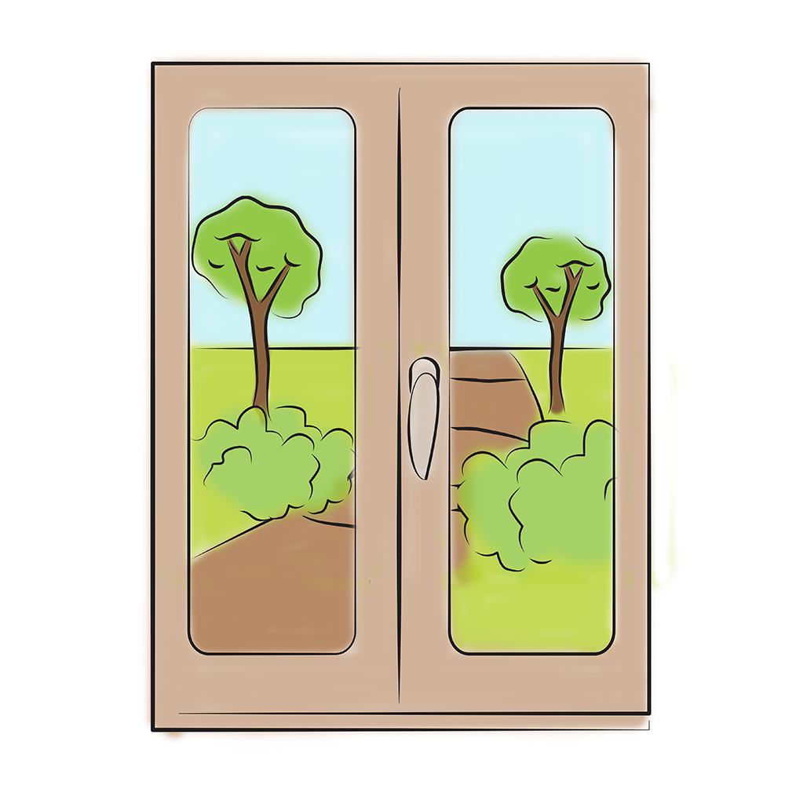
My house has
tall, high windows
for seeing out.
© Copyright MED-EL 2020

Slide 6
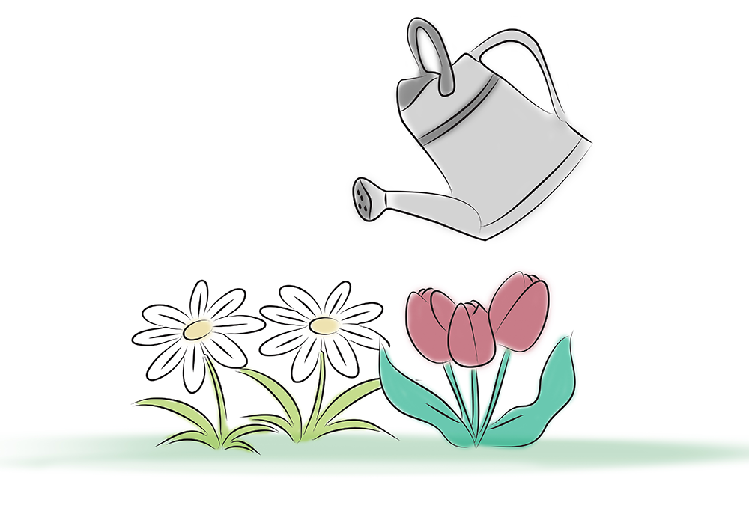
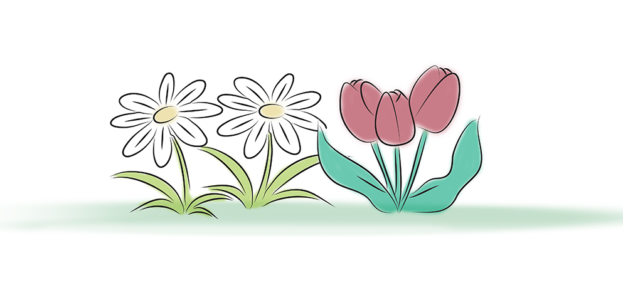
My house has
for growing things.
a hot, sunny garden
© Copyright MED-EL 2020

Slide 7
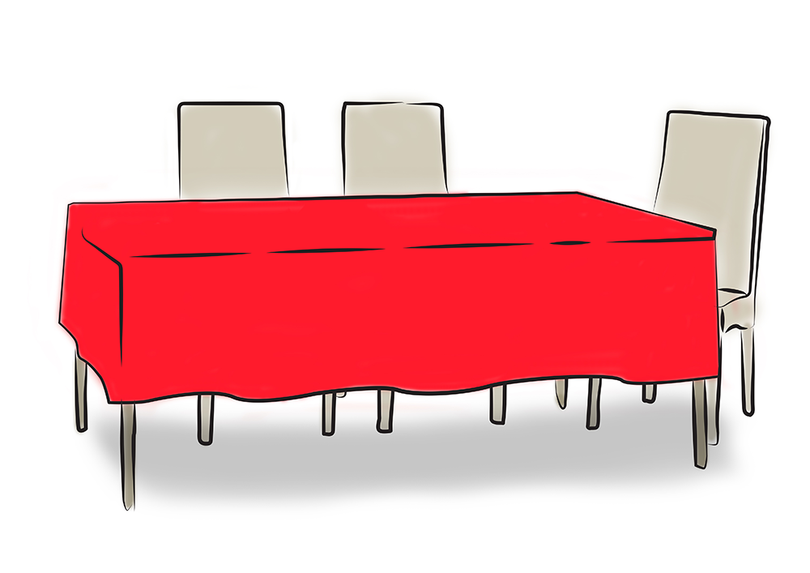
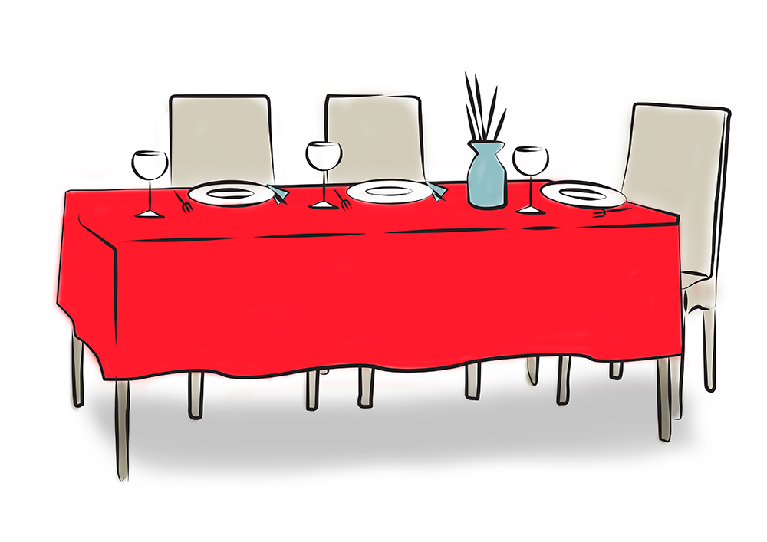
My house has
a table with
a red cloth
for eating at.
© Copyright MED-EL 2020

Slide 8
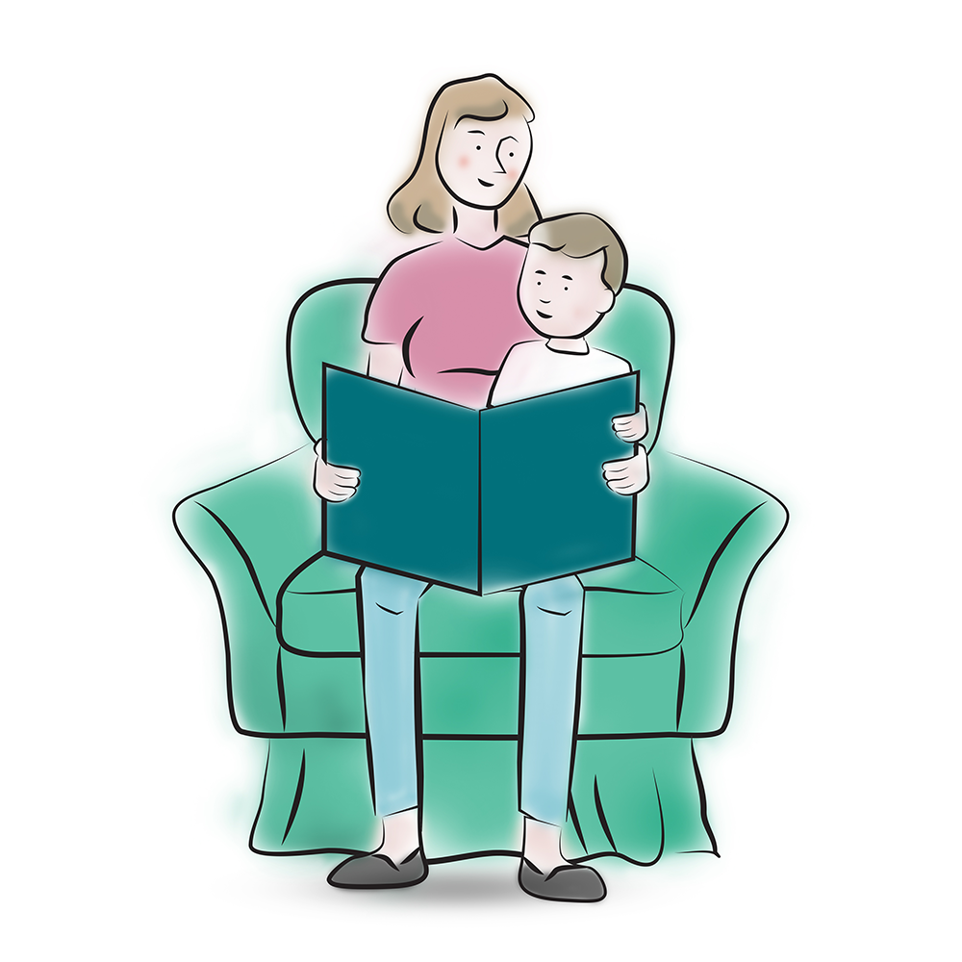

My house has
an old arm chair
for reading together.
© Copyright MED-EL 2020

Slide 9
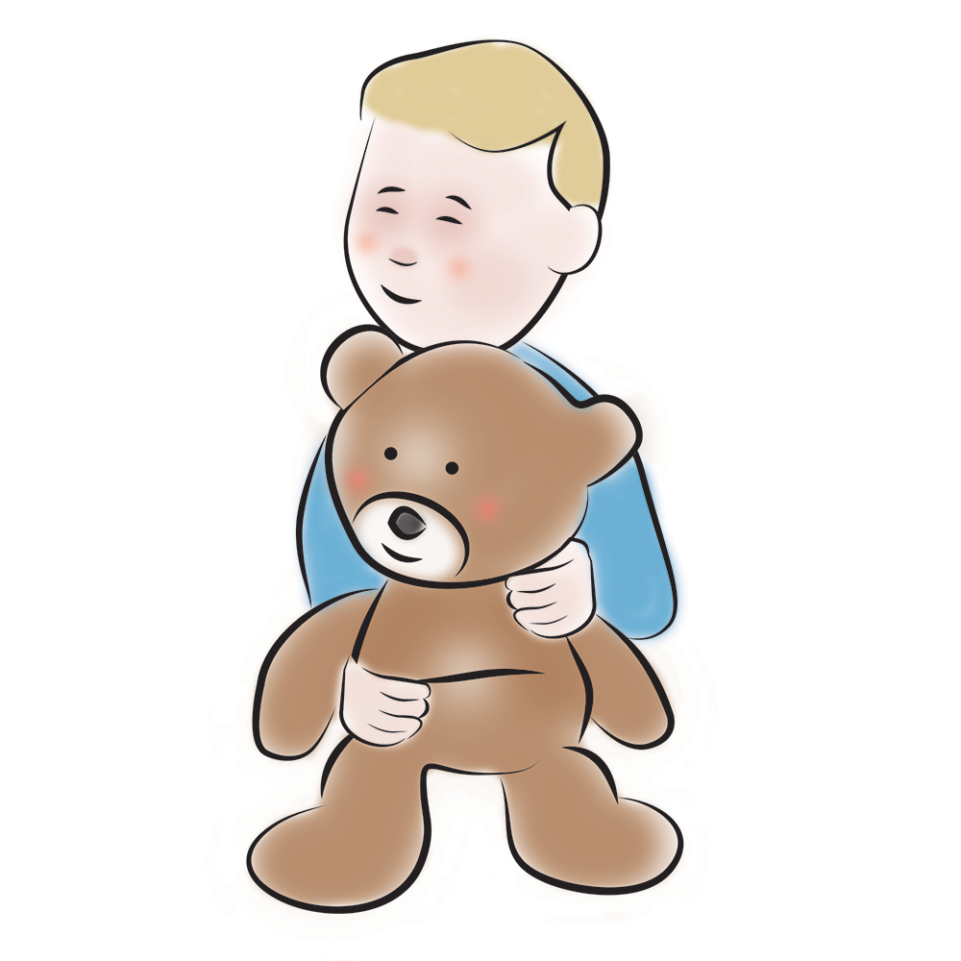
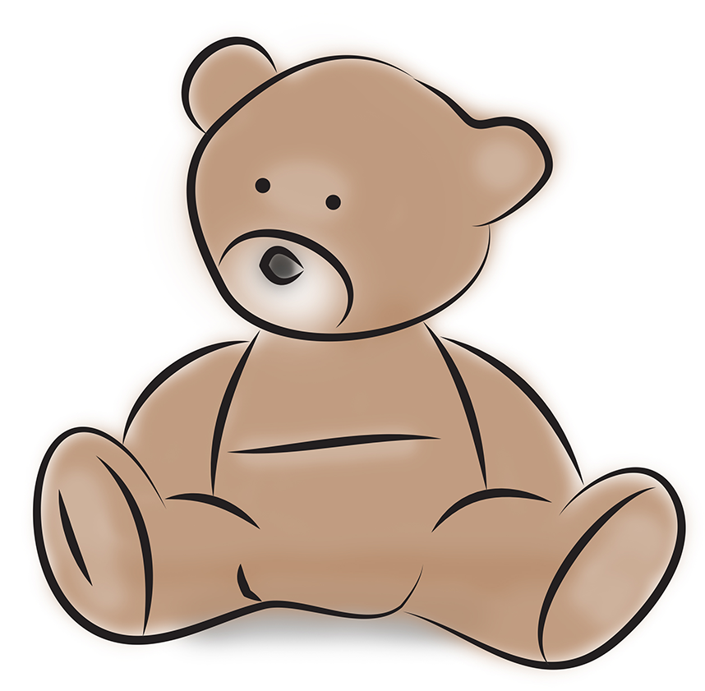
My house has
my favourite bear
for cuddling up.
© Copyright MED-EL 2020

Slide 10
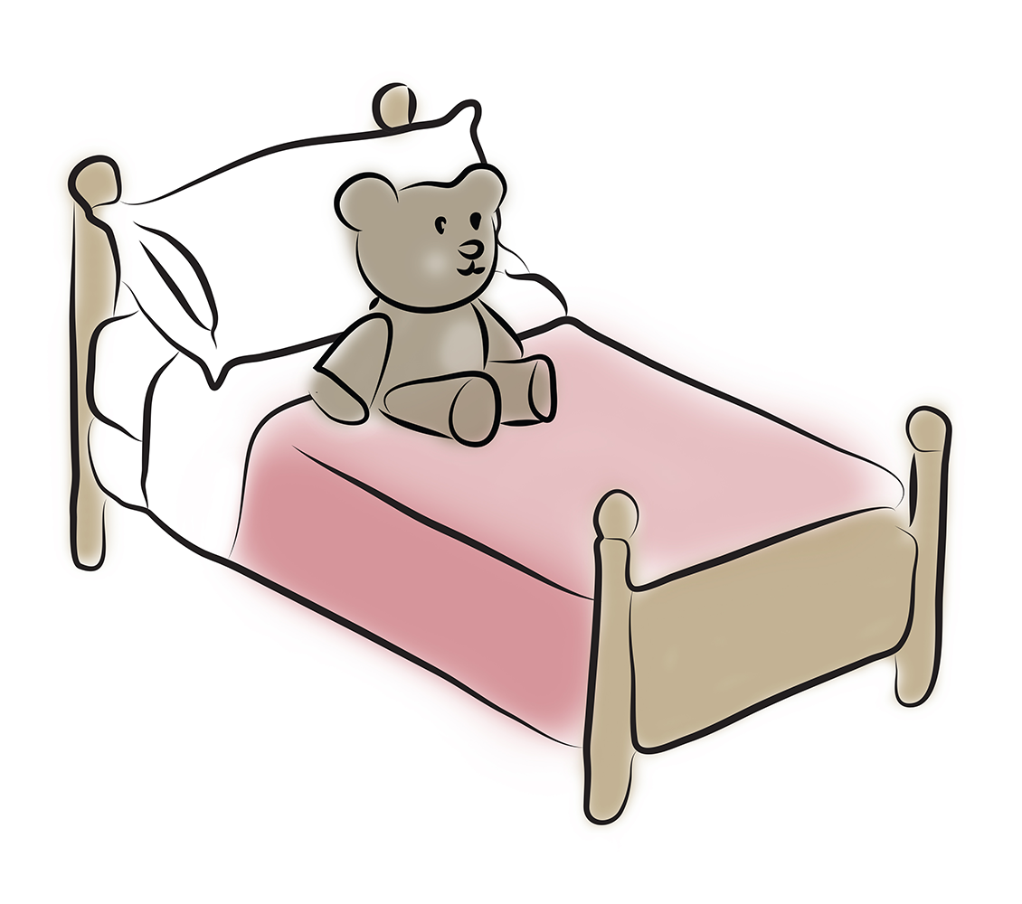
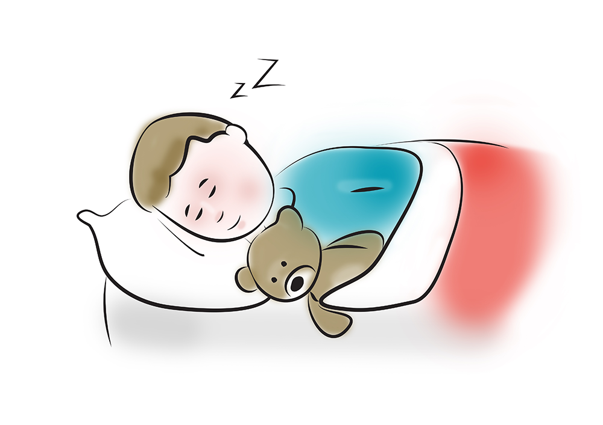
My house has
Night night.
a soft cosy bed
for sleeping in.
© Copyright MED-EL 2020

Slide 11


