Slide 1
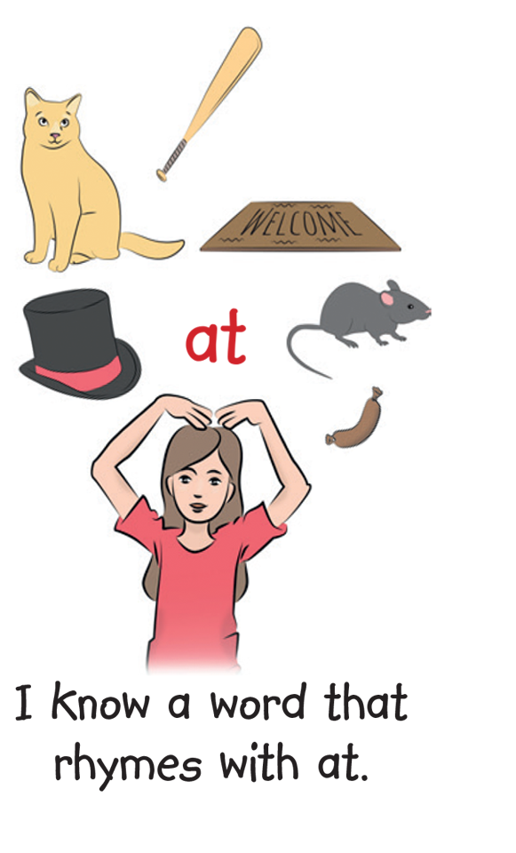
© Copyright MED-EL 2020

Slide 2
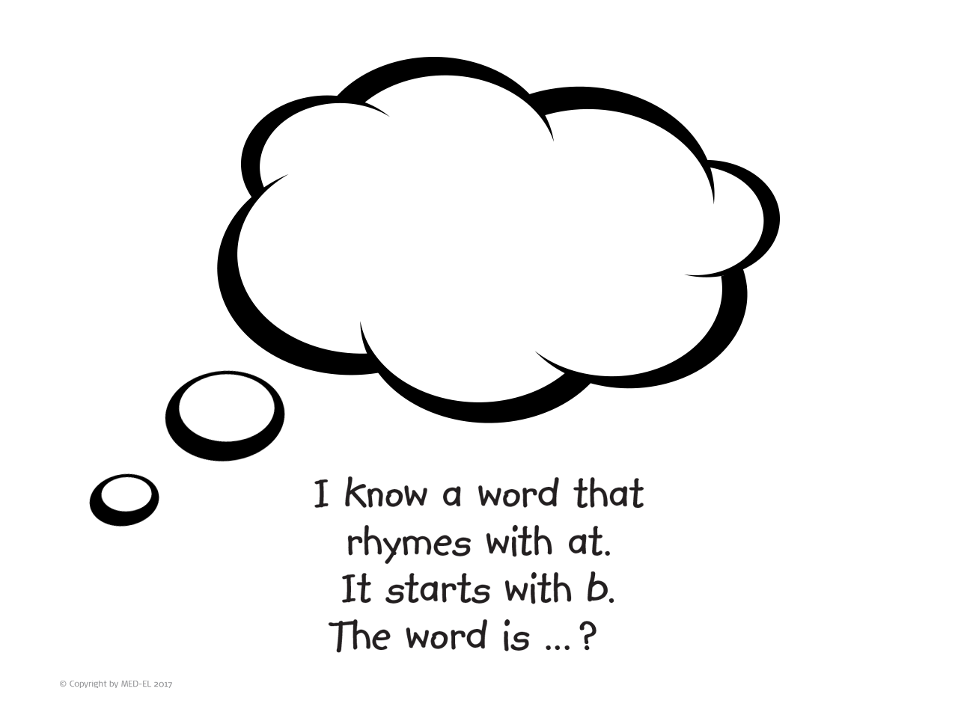
© Copyright MED-EL 2020

Slide 3
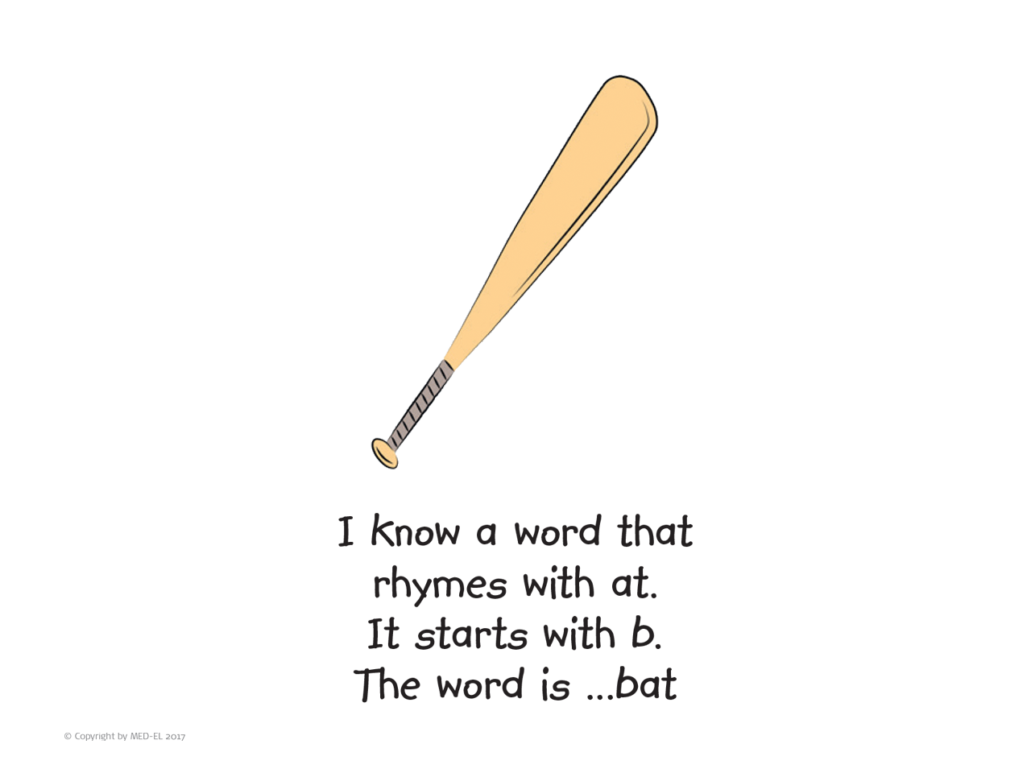
© Copyright MED-EL 2020

Slide 4

© Copyright MED-EL 2020

Slide 5
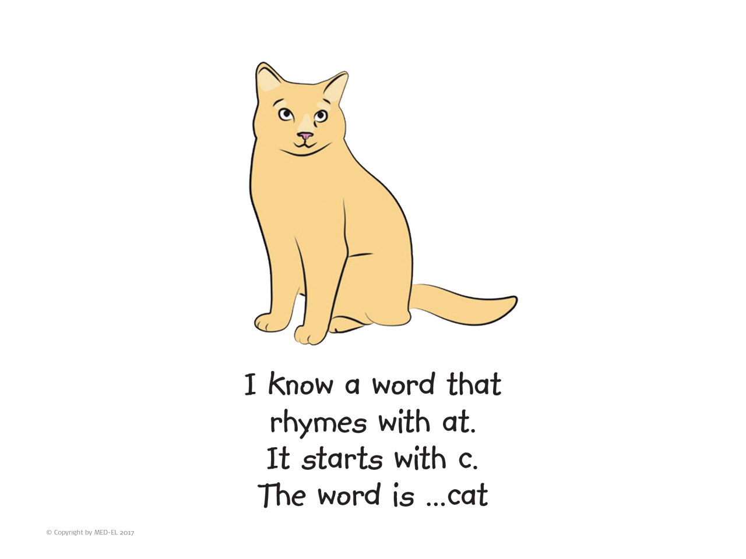
© Copyright MED-EL 2020

Slide 6

© Copyright MED-EL 2020

Slide 7
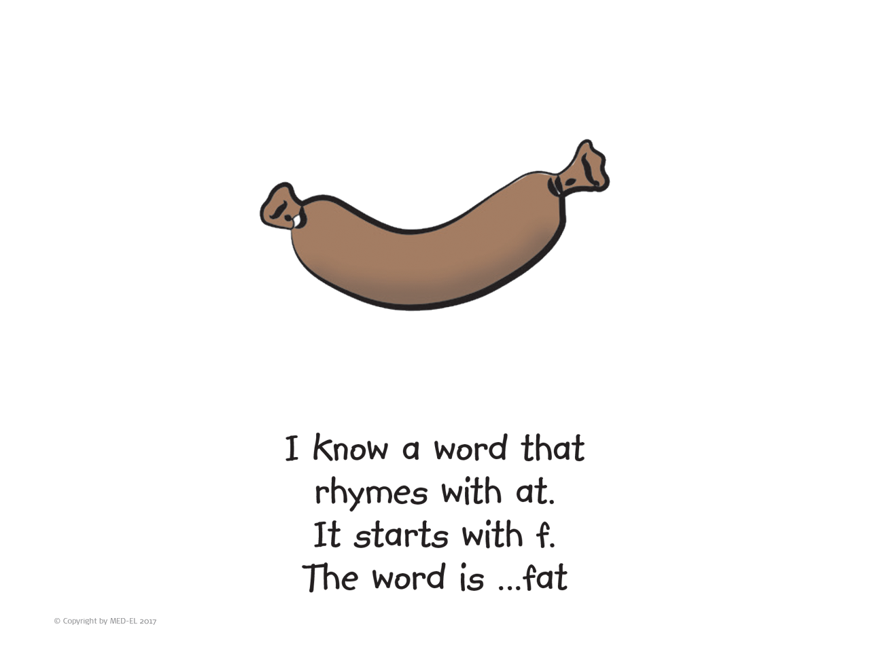
© Copyright MED-EL 2020

Slide 8

© Copyright MED-EL 2020

Slide 9
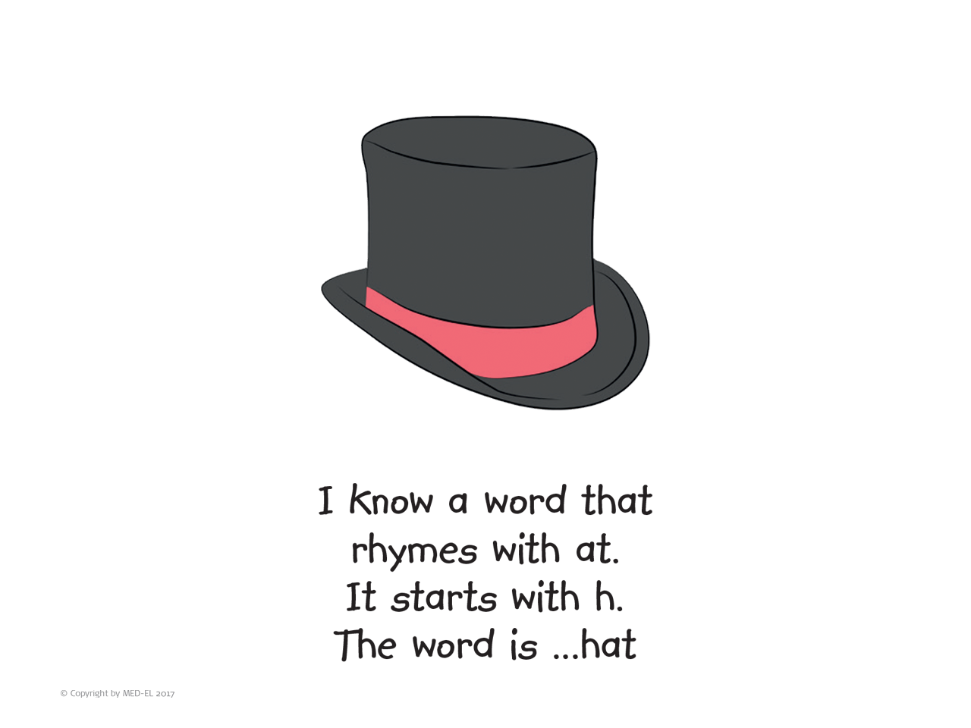
© Copyright MED-EL 2020

Slide 10

© Copyright MED-EL 2020

Slide 11
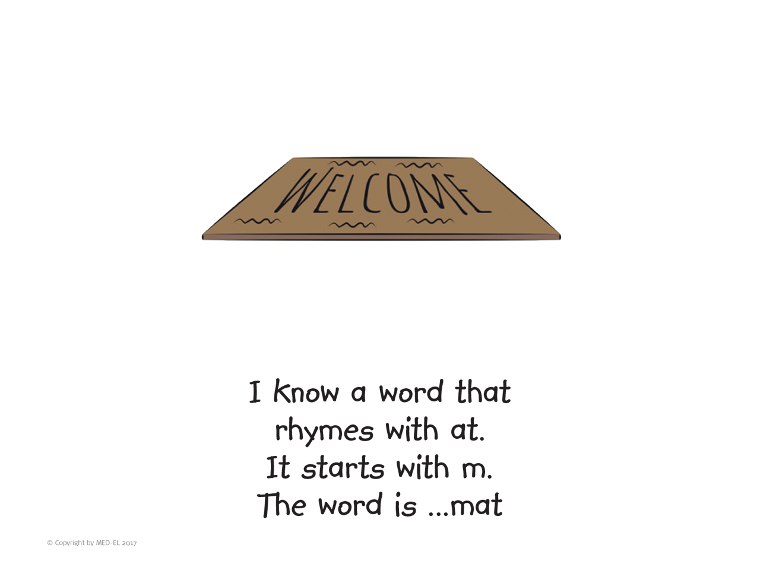
© Copyright MED-EL 2020

Slide 12

© Copyright MED-EL 2020

Slide 13
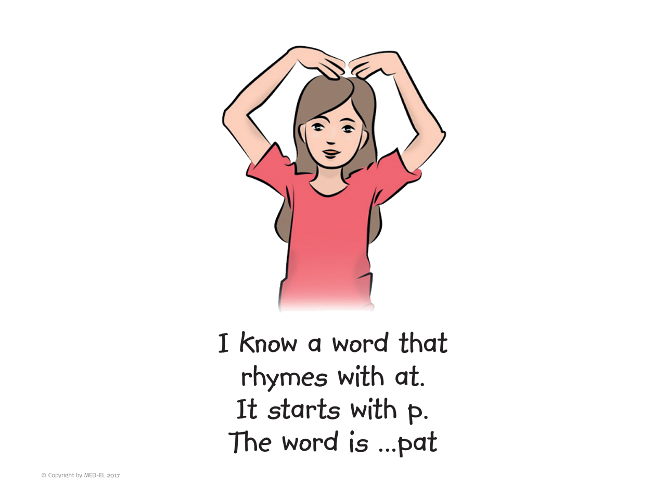
© Copyright MED-EL 2020

Slide 14

© Copyright MED-EL 2020

Slide 15
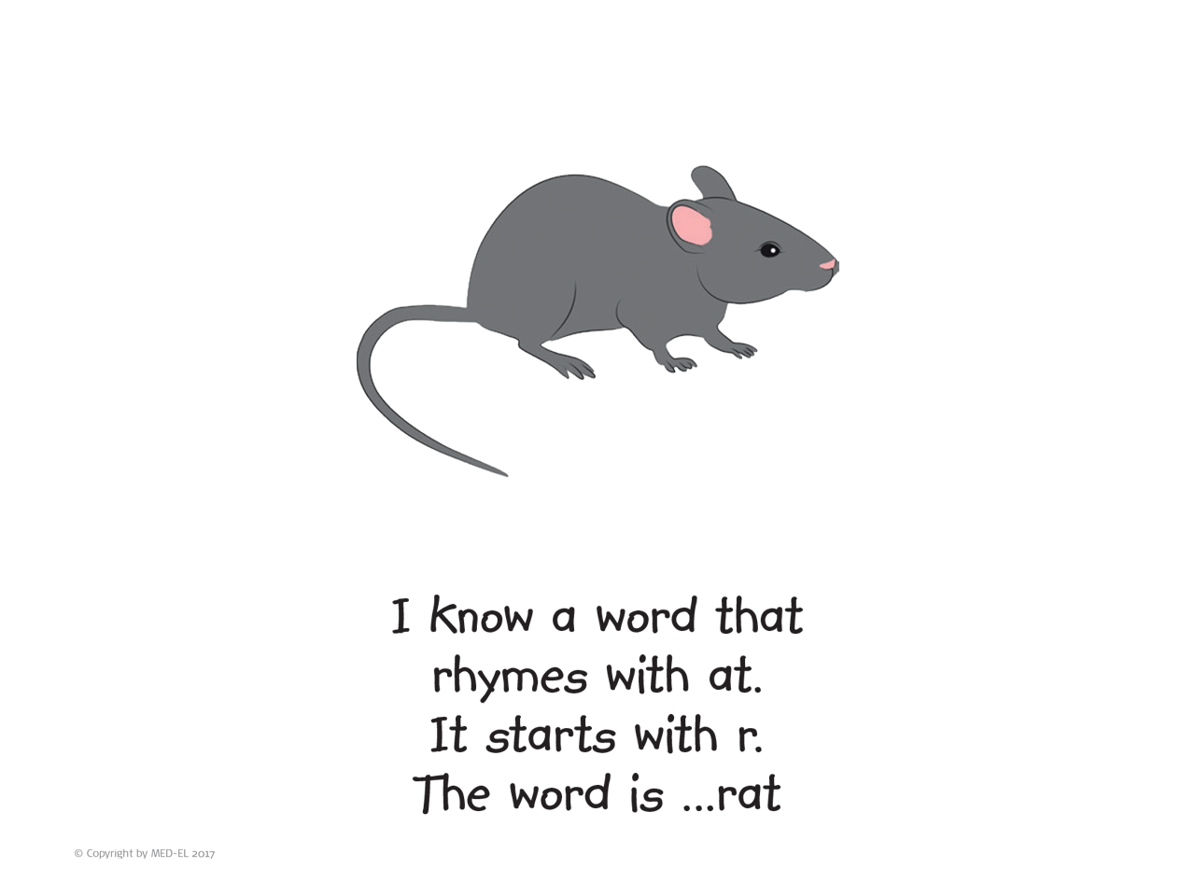
© Copyright MED-EL 2020

Slide 16

© Copyright MED-EL 2020

Slide 17
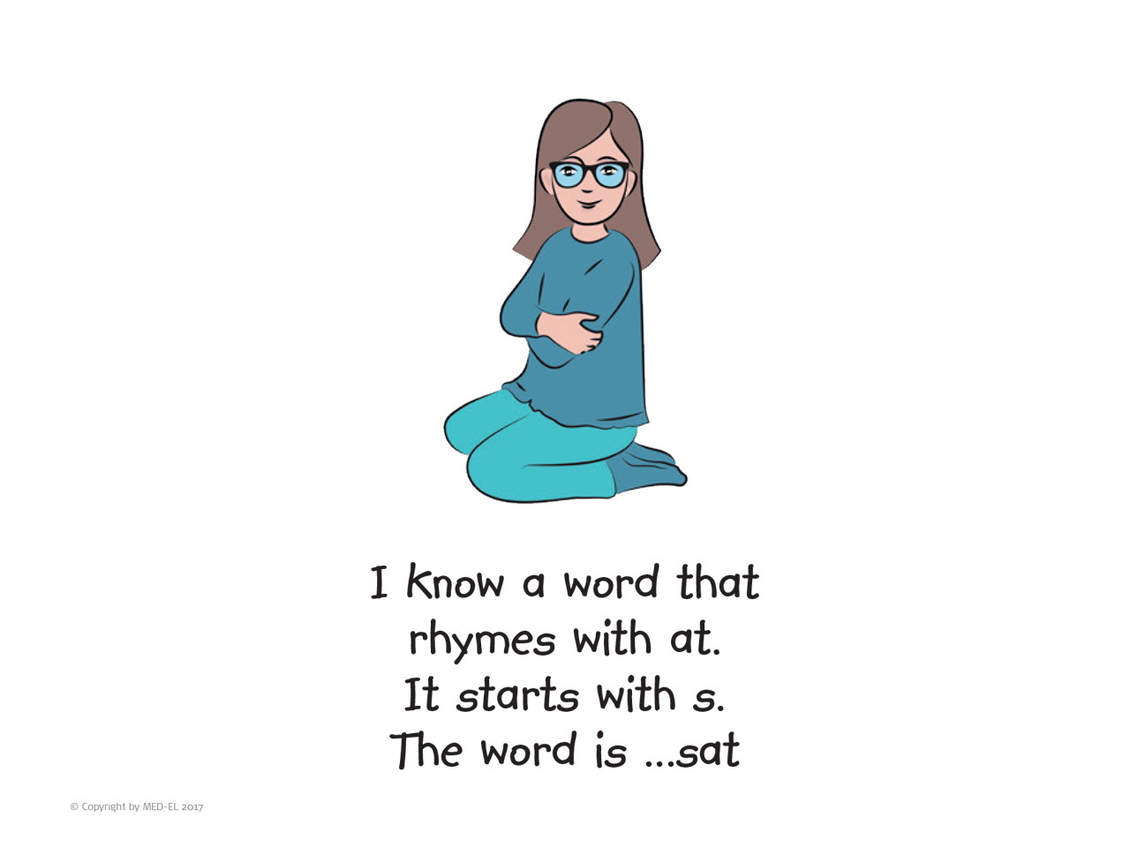
© Copyright MED-EL 2020

Slide 18
