Slide 1
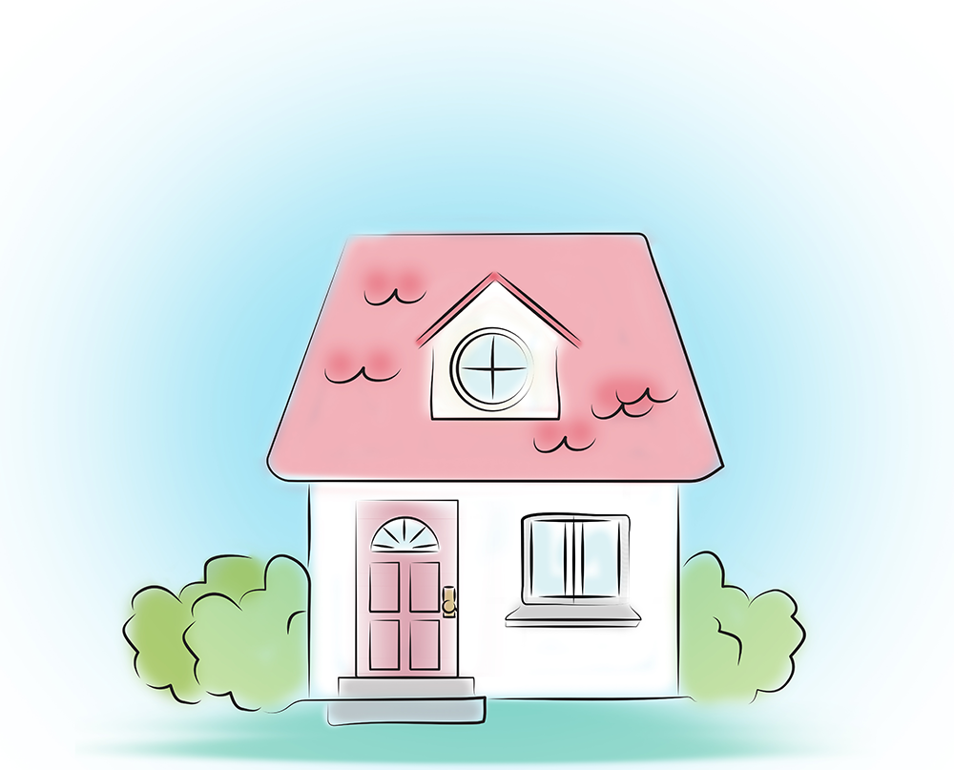
My house

Slide 2
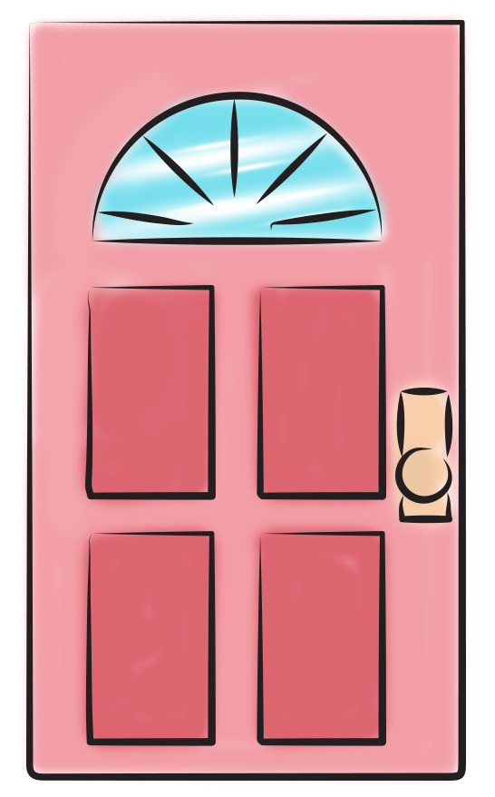
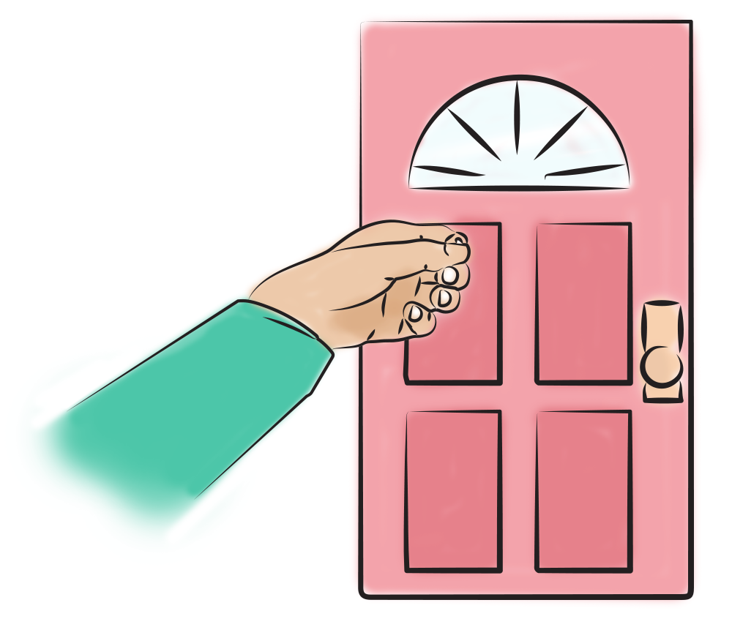
My house has
for knocking on.
a big front door

Slide 3
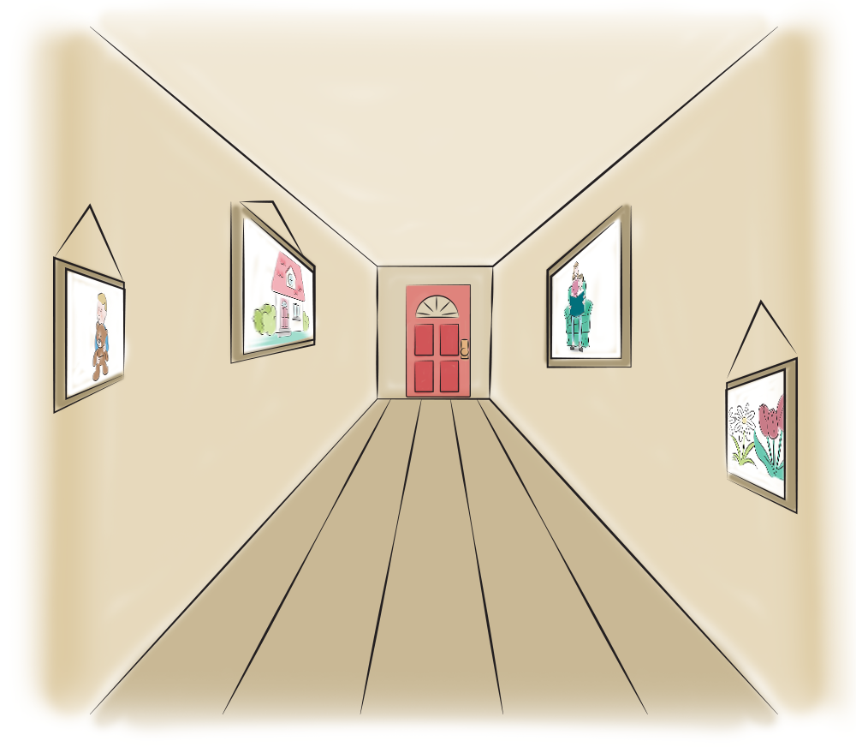
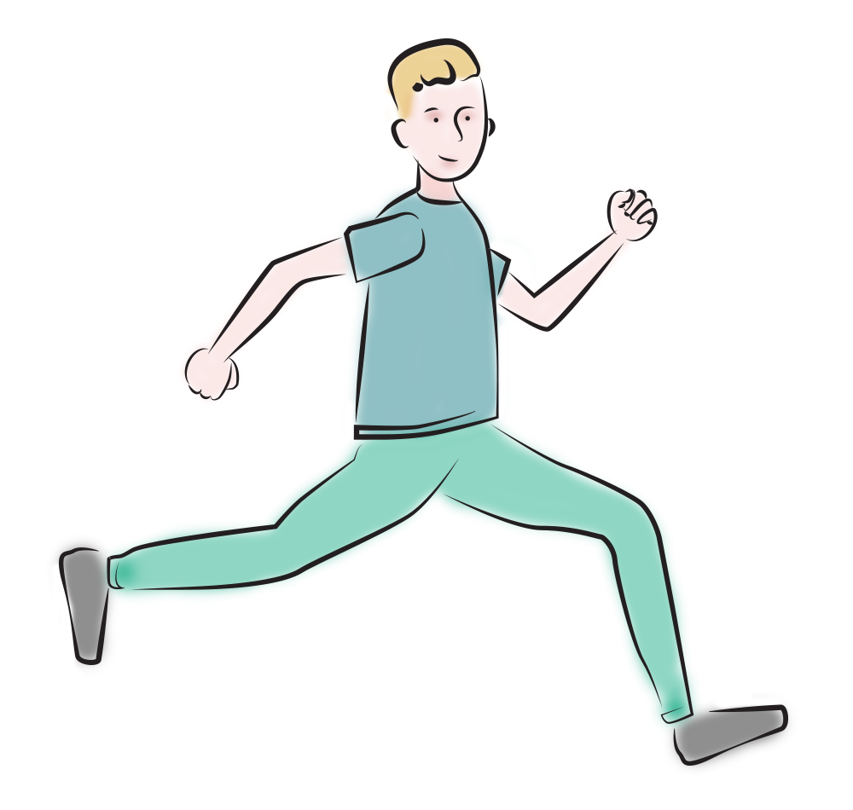
My house has
a long narrow hall
for running through.

Slide 4

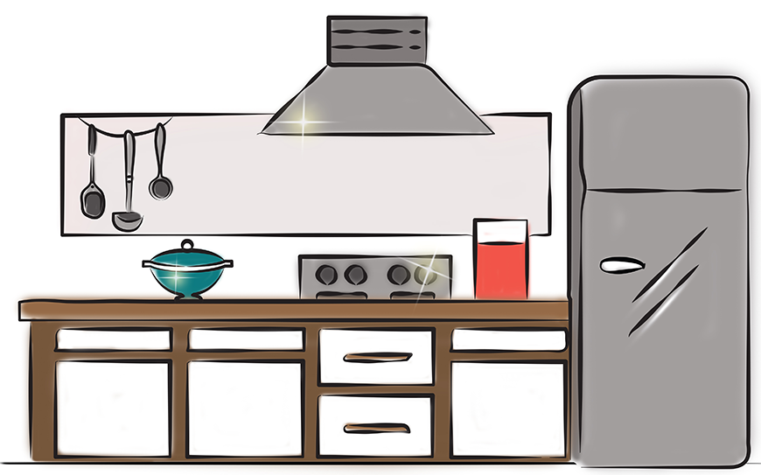
My house has
a kitchen filled
with shiny things
for cooking with.

Slide 5
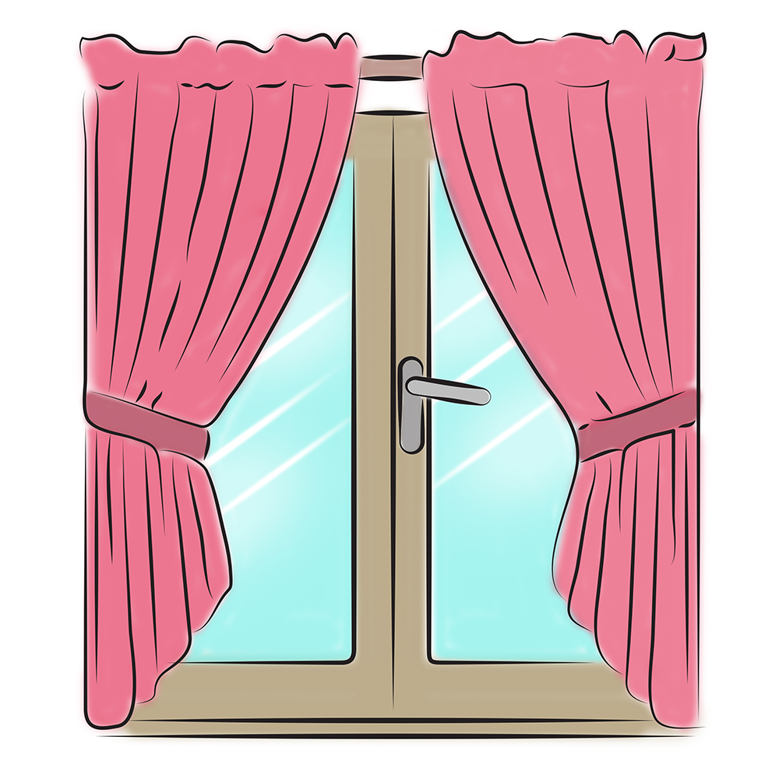
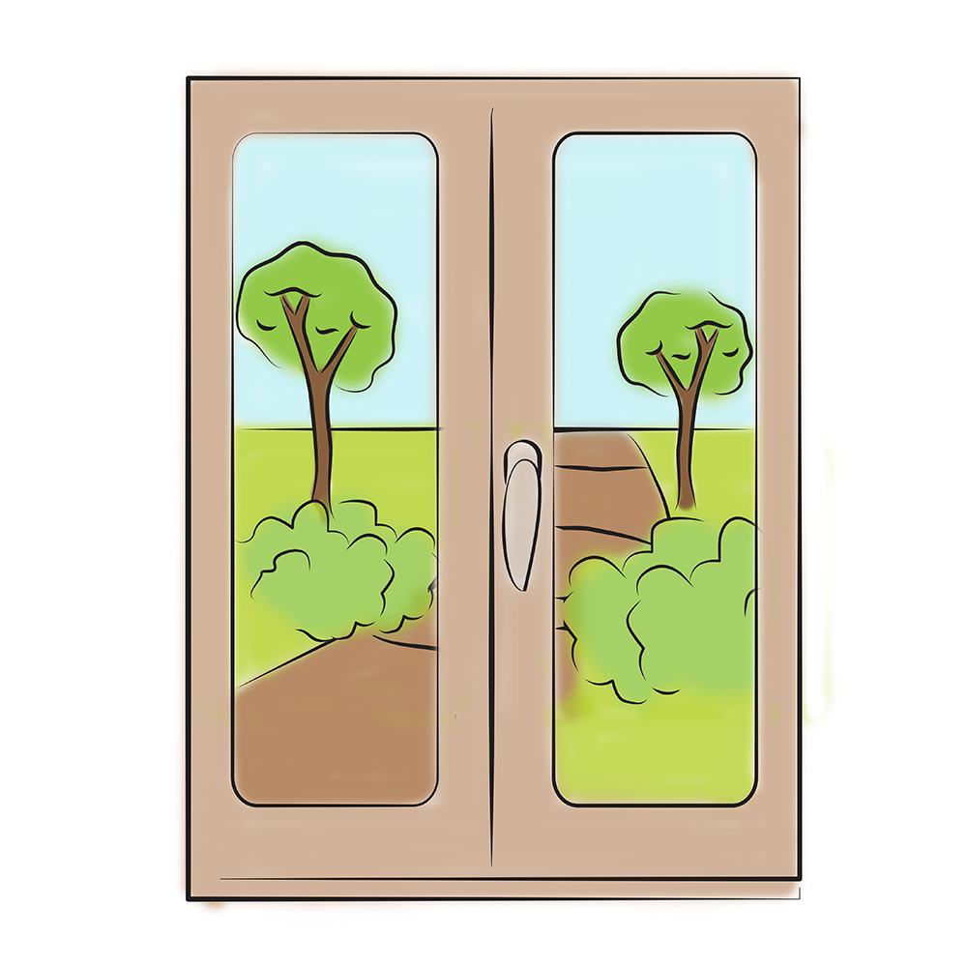
My house has
tall, high windows
for seeing out.

Slide 6
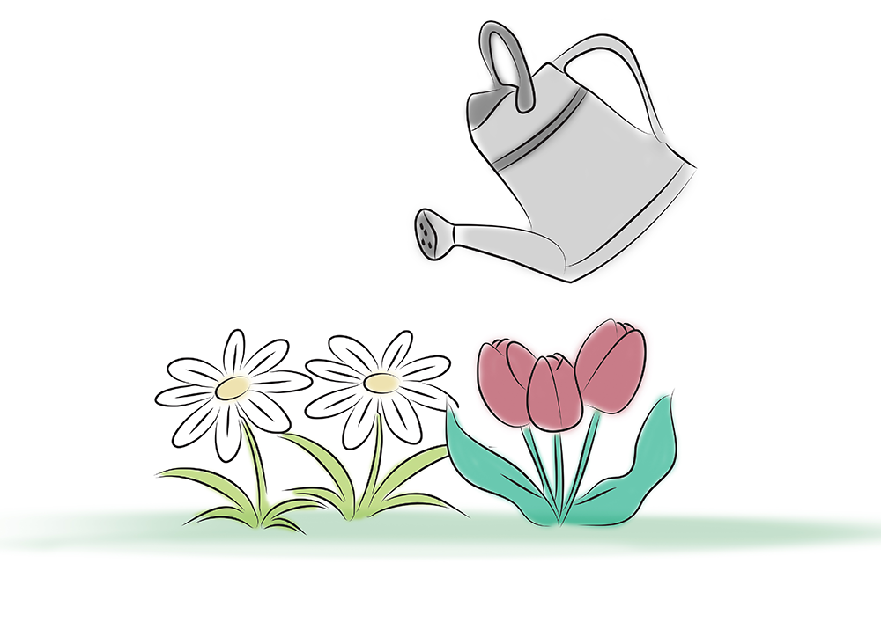
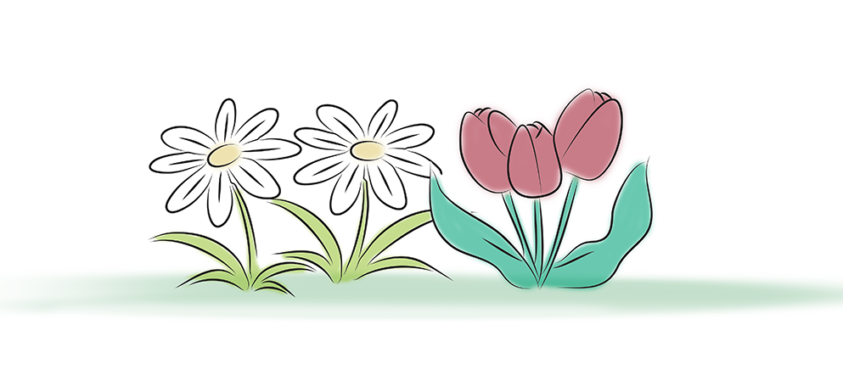
My house has
for growing things.
a hot, sunny garden

Slide 7
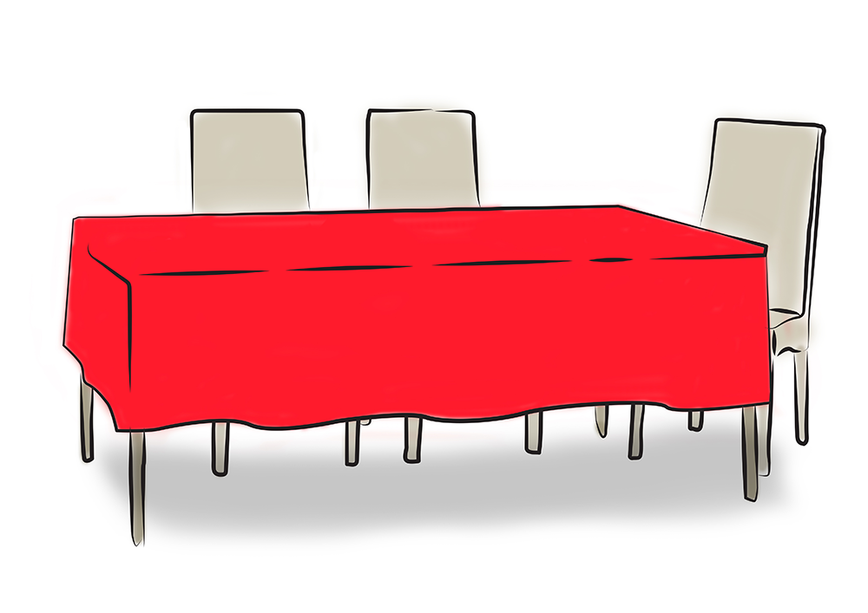
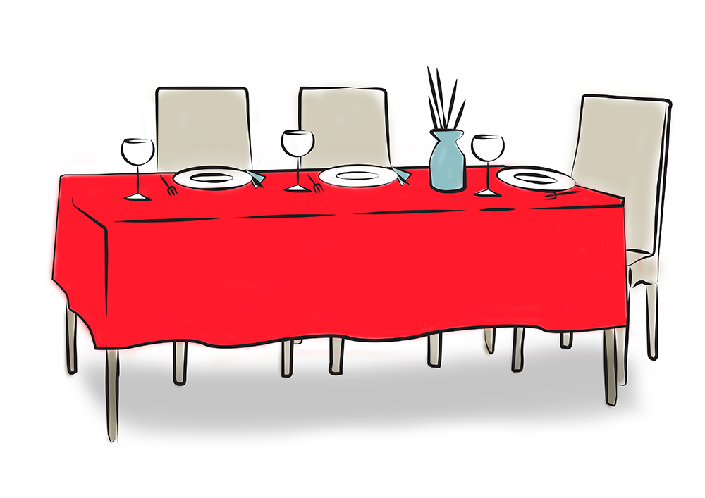
My house has
a table with
a red cloth
for eating at.

Slide 8
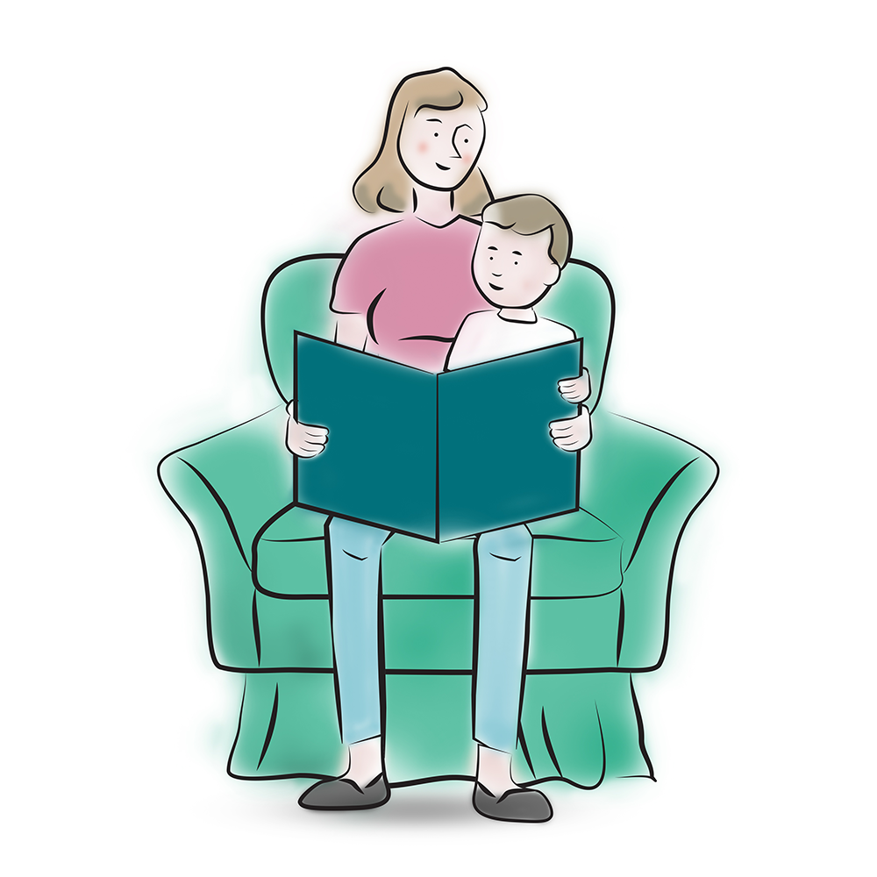
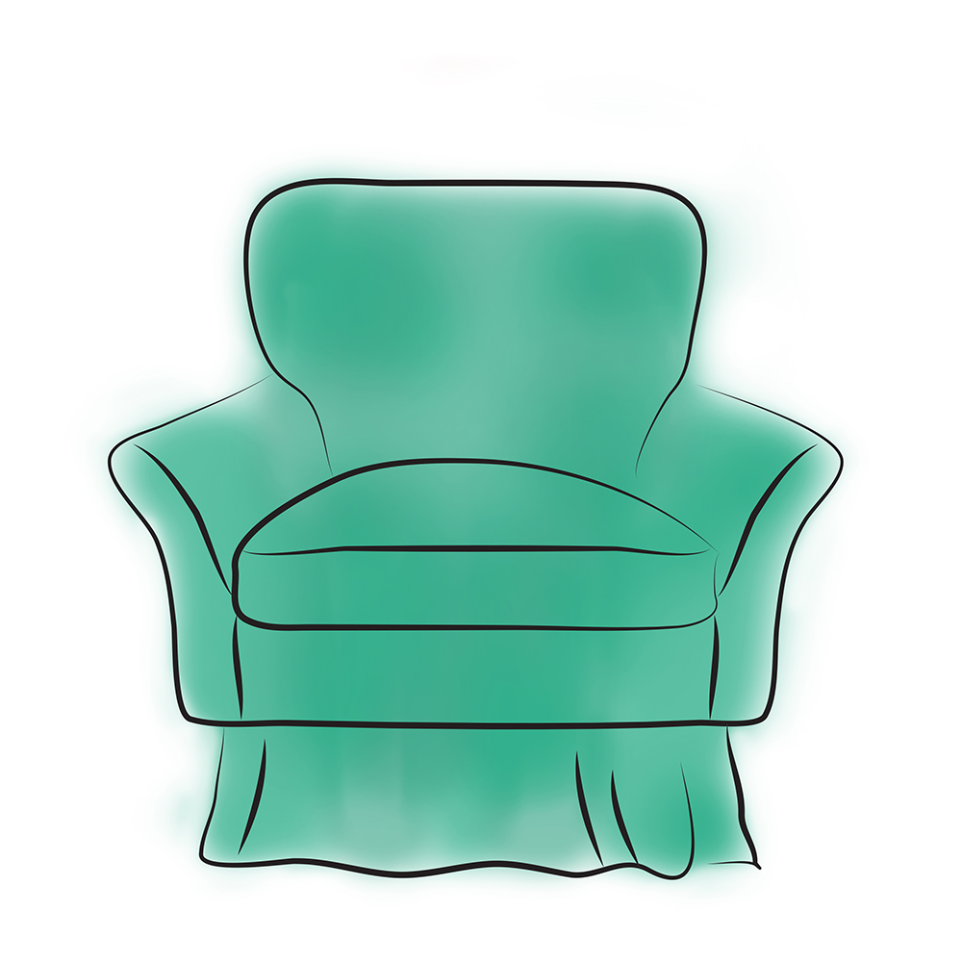
My house has
an old arm chair
for reading together.

Slide 9
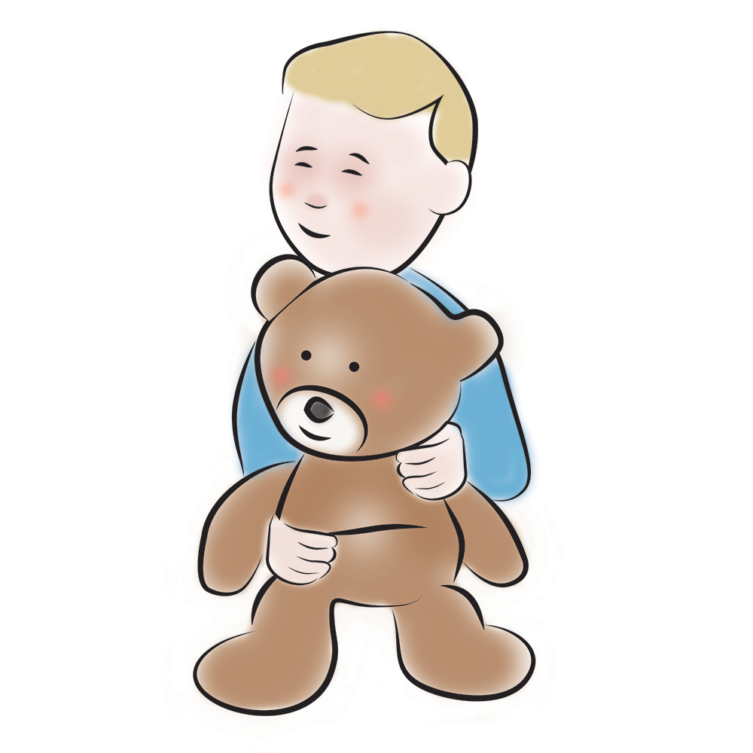

My house has
my favourite bear
for cuddling up.

Slide 10
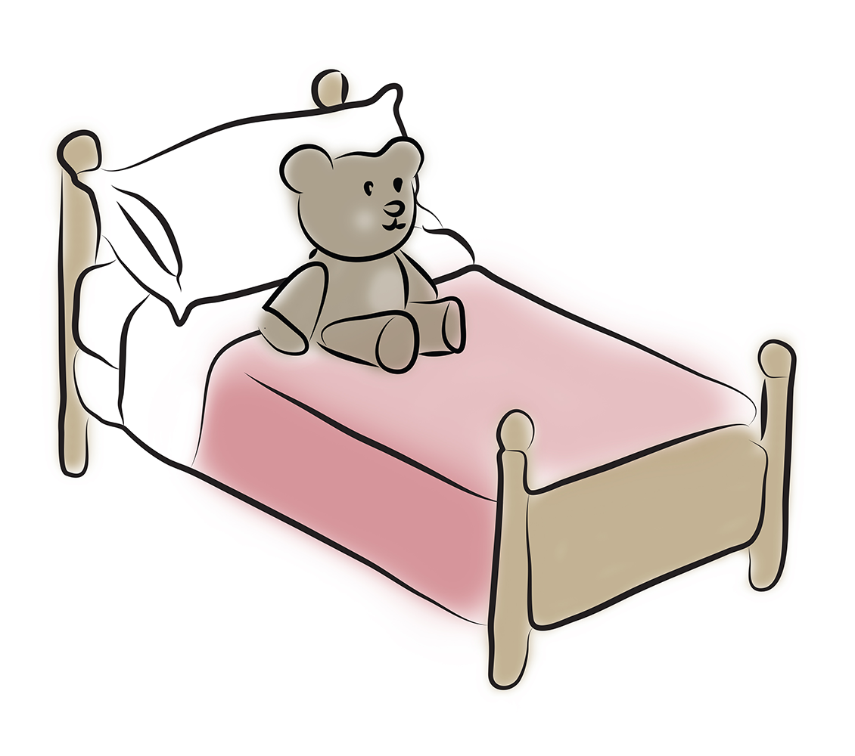
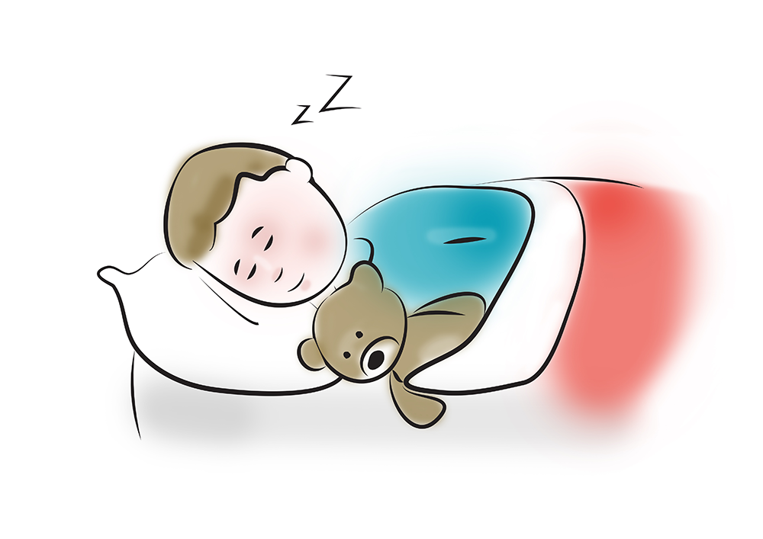
My house has
Night night.
a soft cosy bed
for sleeping in.

Slide 11
Any questions?
Contact us!
rehabilitation@medel.com

